Slide 1
NCI update – analyzing CyTOF data
12-6-2024
Ty Bottorff – Bioinformatics postdoc
Linsley lab

Slide 2
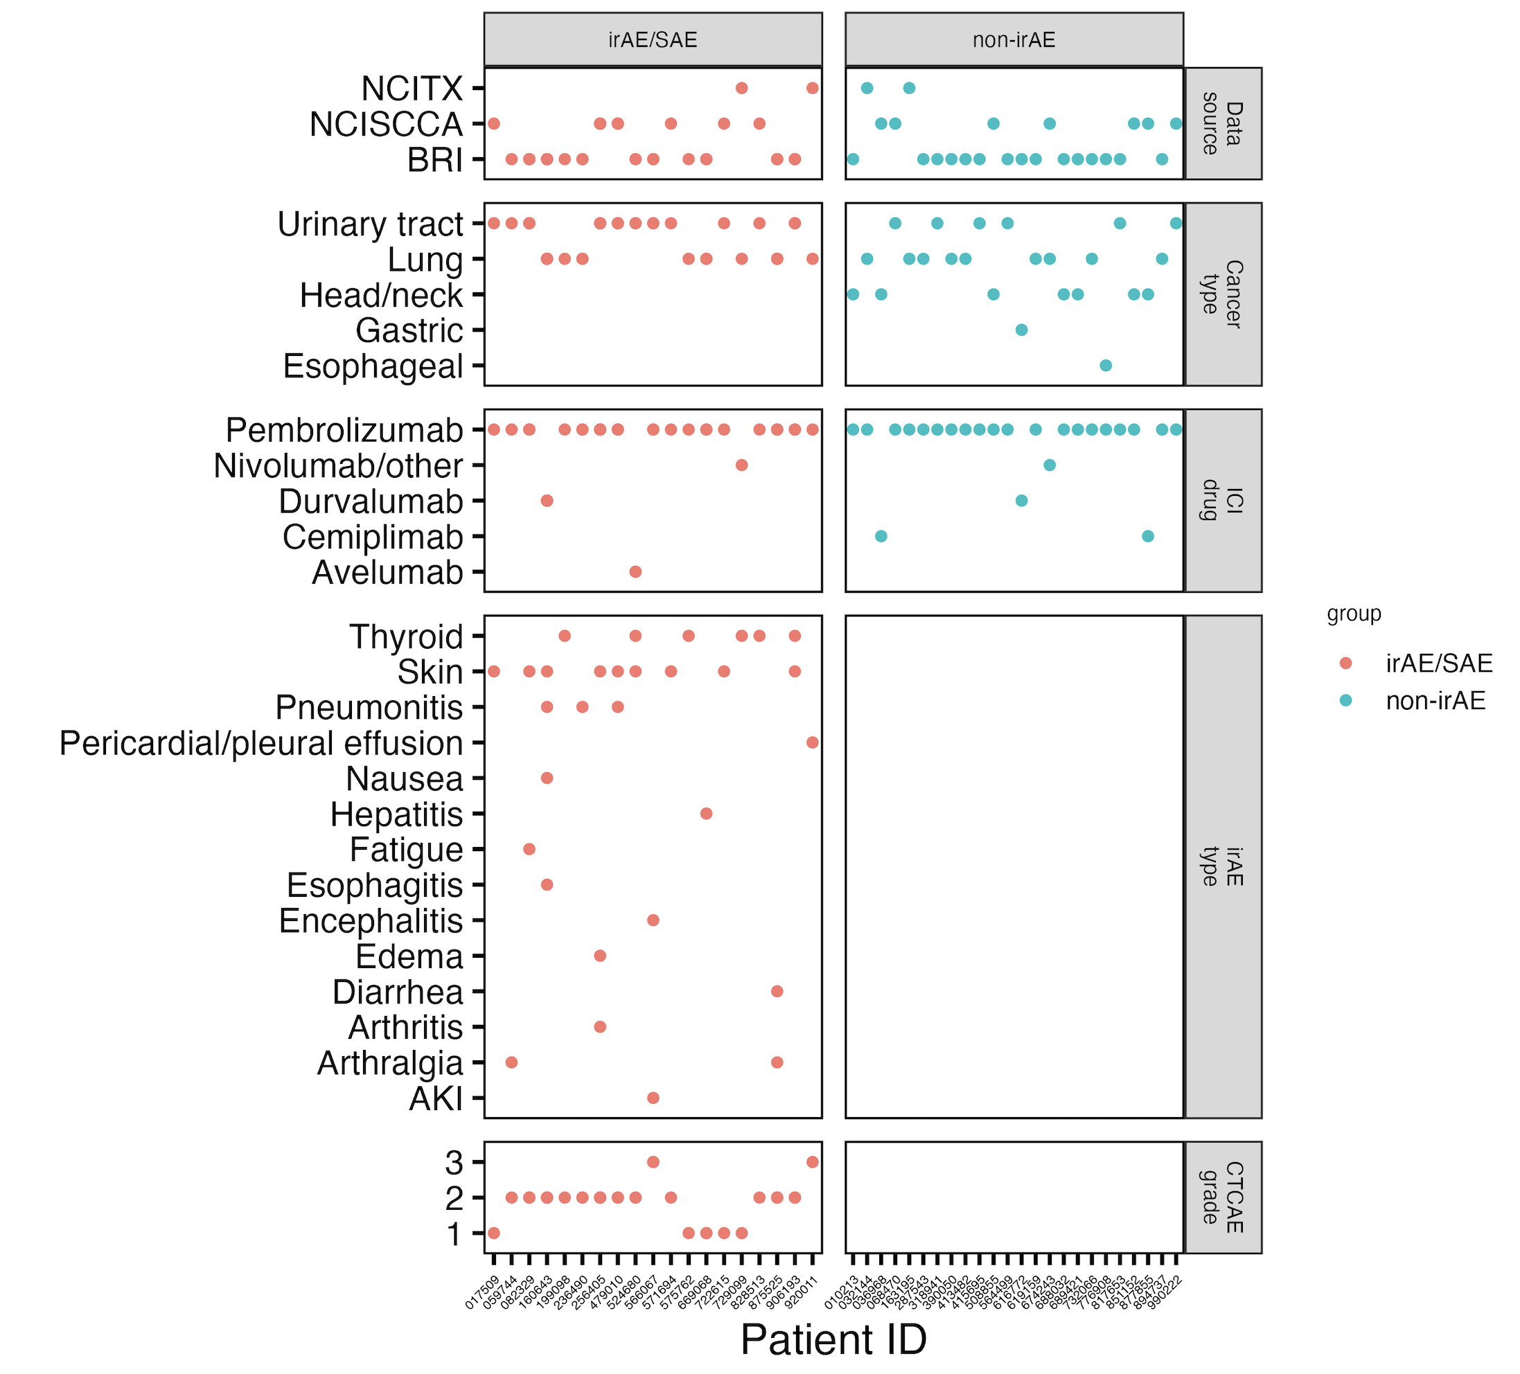
Cancer cohort metadata
Notes:
Ask Jane if grouping arthralgia and arthritis ok here for rheumatoid group (n = 3)

Slide 3
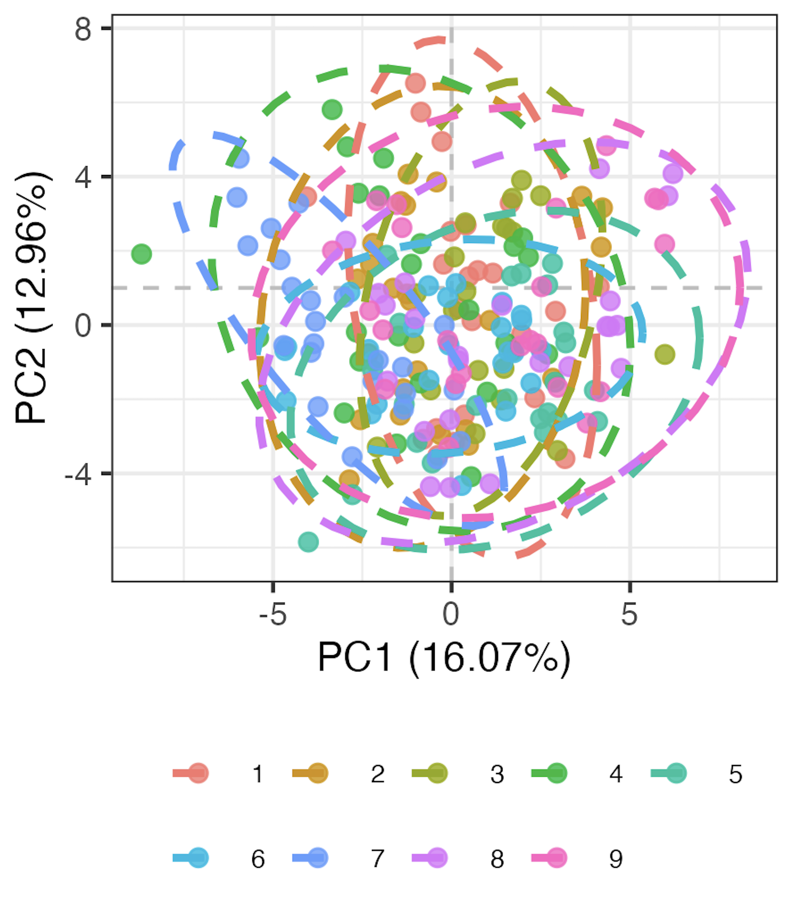
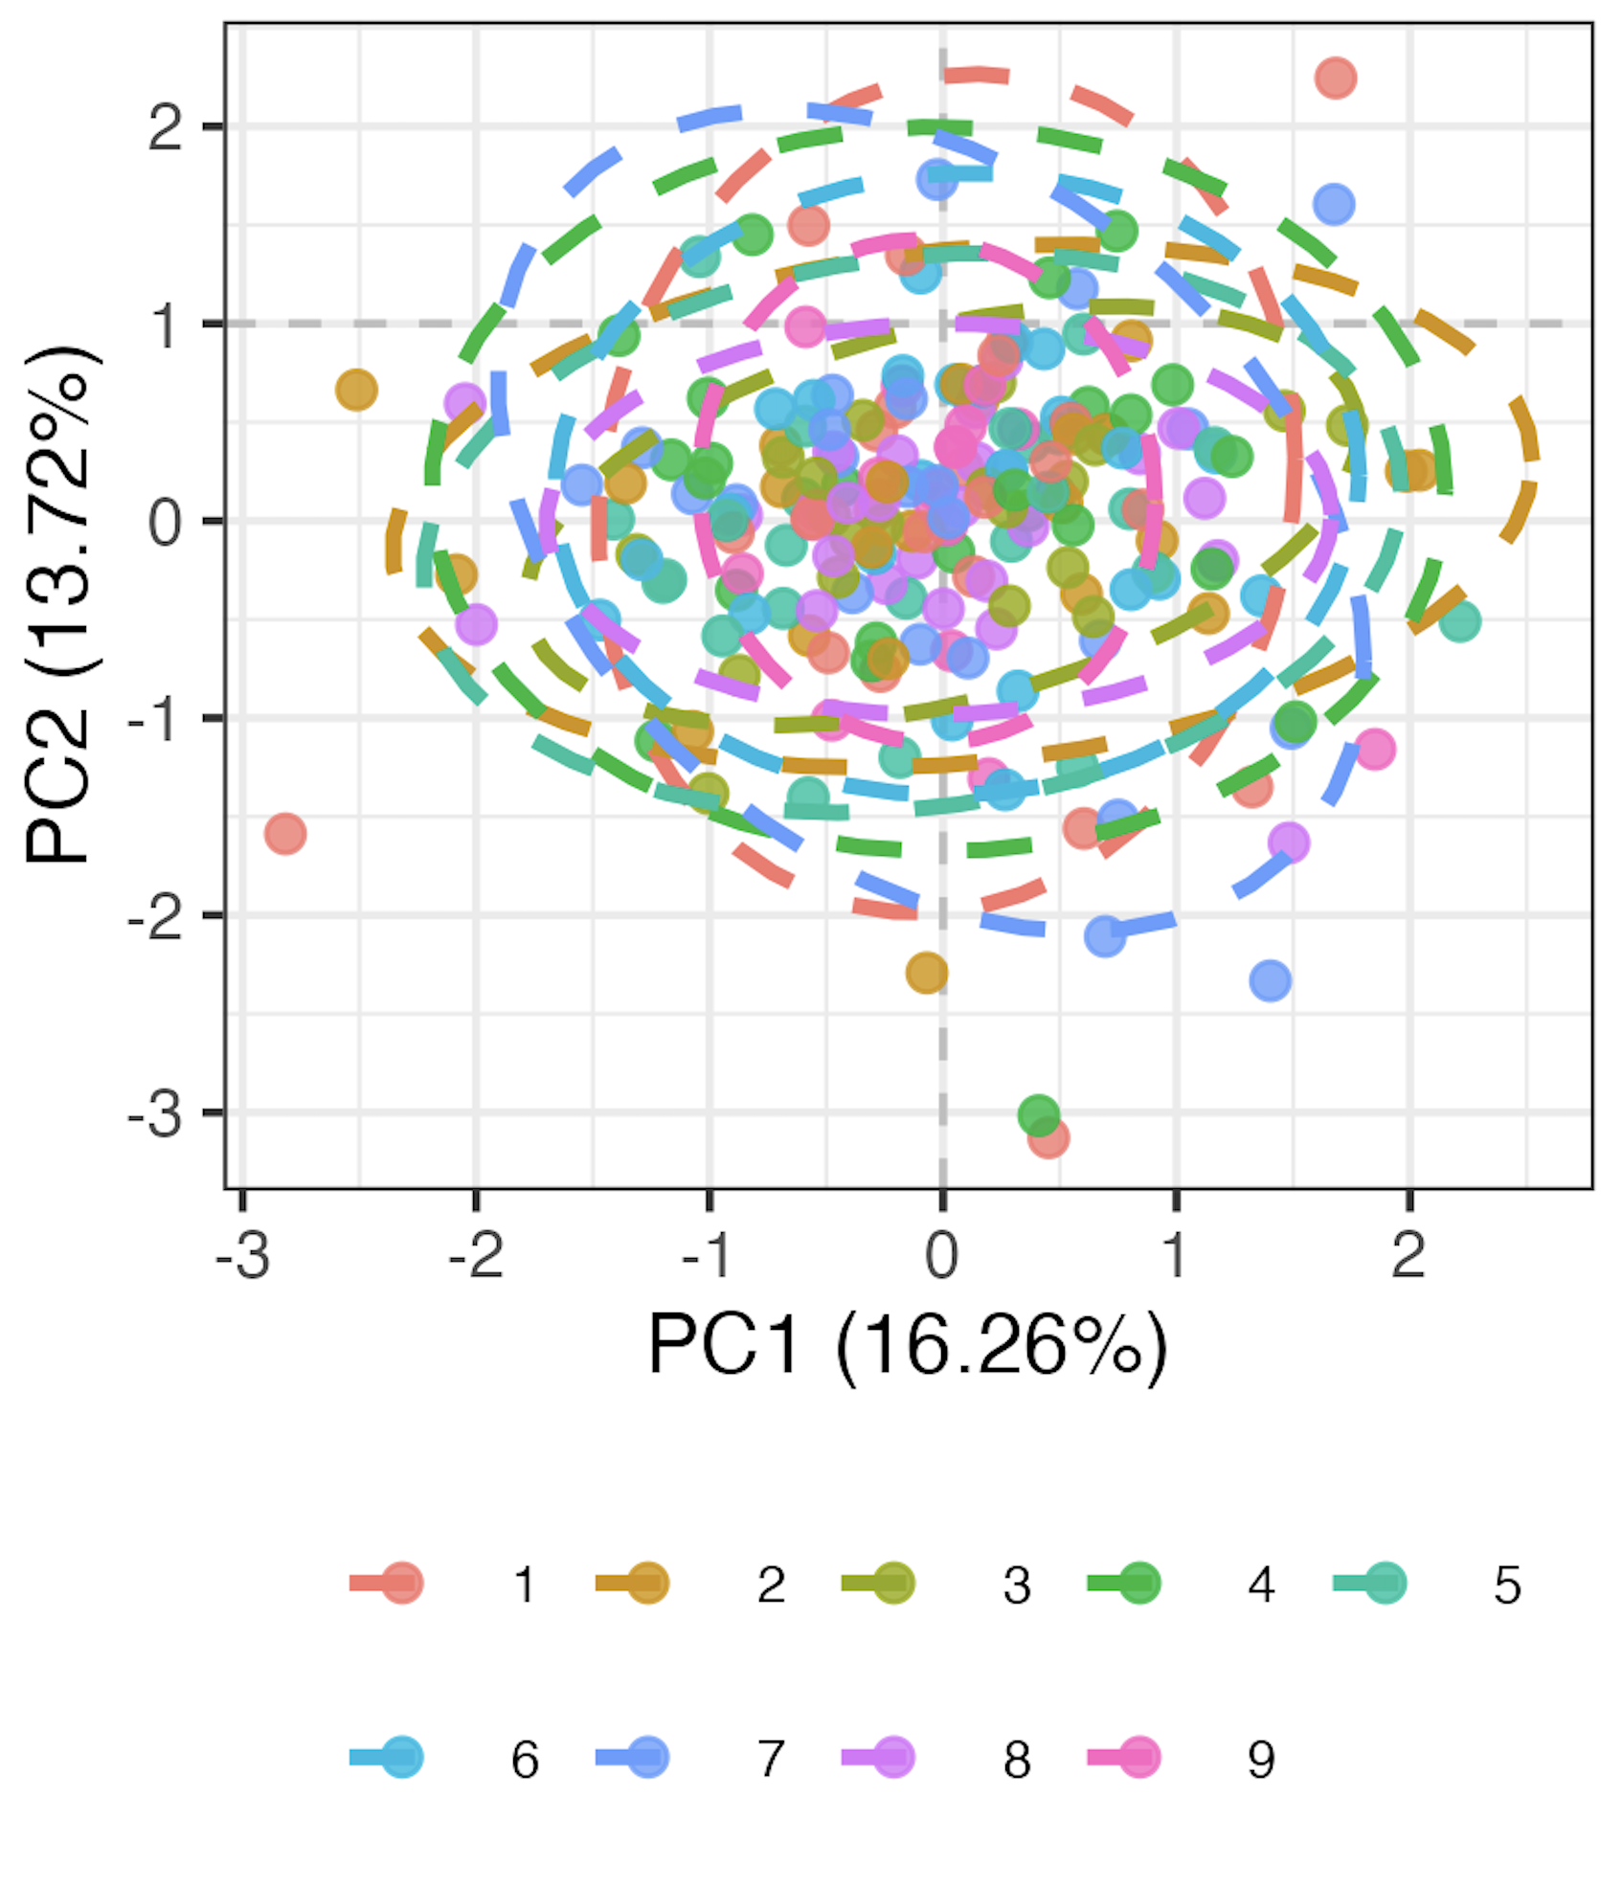
Methods overview
Remove 9 features with high technical variation
Normalize percent of parent data
Logit transform, Z-scale
Run mixed-effects LM for each of 71 remaining features, take residuals as batch-corrected data
Pre
Post
model <- lmer(freq ~ batch + (1|patient_id))
Batch
Batch
Notes:
Logit transforms 0-1 to –inf, inf to normalize data
This is likely overcorrecting but no better idea (yet)

Slide 4
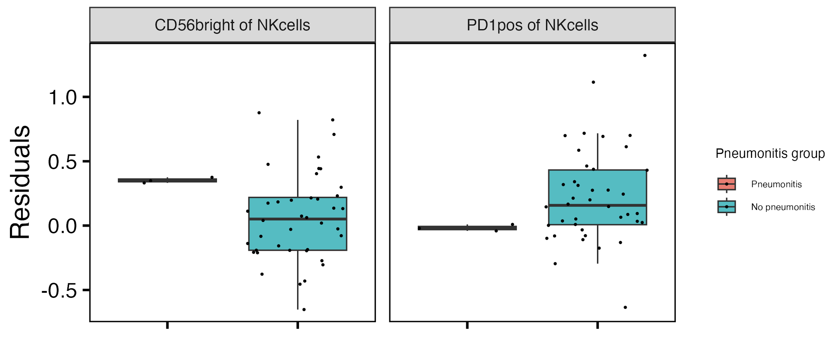
Baseline CD56^{bright} of NK cells frequency higher, PD1⁺ of NK cells frequency lower in those developing pneumonitis
**
**
**: padj < 0.01
Notes:
if including pleural effusion, then PD1+ of NKs drops (padj > 0.05) but it doesn’t matter for CD56bright of NKs

Slide 5
Baseline feature module methods
For each irAE group comparison
for each feature, test for difference in baseline frequency distributions between irAE groups
arrange by pval
take top 4 features as top feature module (ignoring 6 features removed for PCA due to > 5% NAs)
Notes:
For features with < 5% NAs, replace NAs with mean

Slide 6
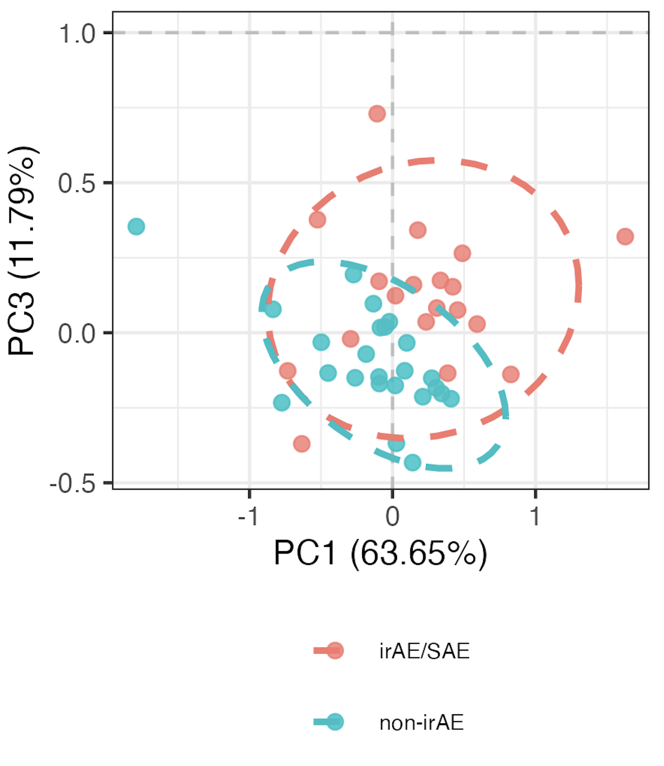
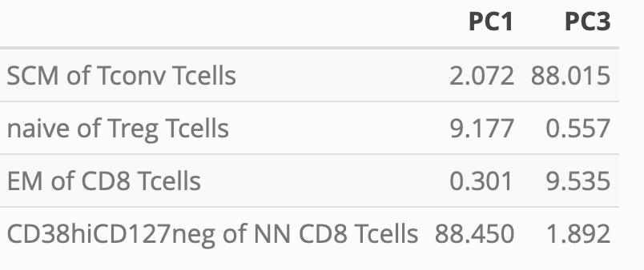
Distinguishing combined irAE group using module of top 4 combined irAE baseline features
PC1/3 contributions
PC1 *
PC3 **
**: p < 0.01, *: p < 0.05
Notes:
Module approach: whittle down # of features (arranging by pval from group comparison) while still retaining > 1 PC with pval < 0.05, ordering kind of arbitrary as padj have ties, so tried not to whittle down TOO much
Should also emphasize that modules are somewhat arbitrary in sense that multiple different configurations of mostly same features would likely work for each module approach taken here

Slide 7
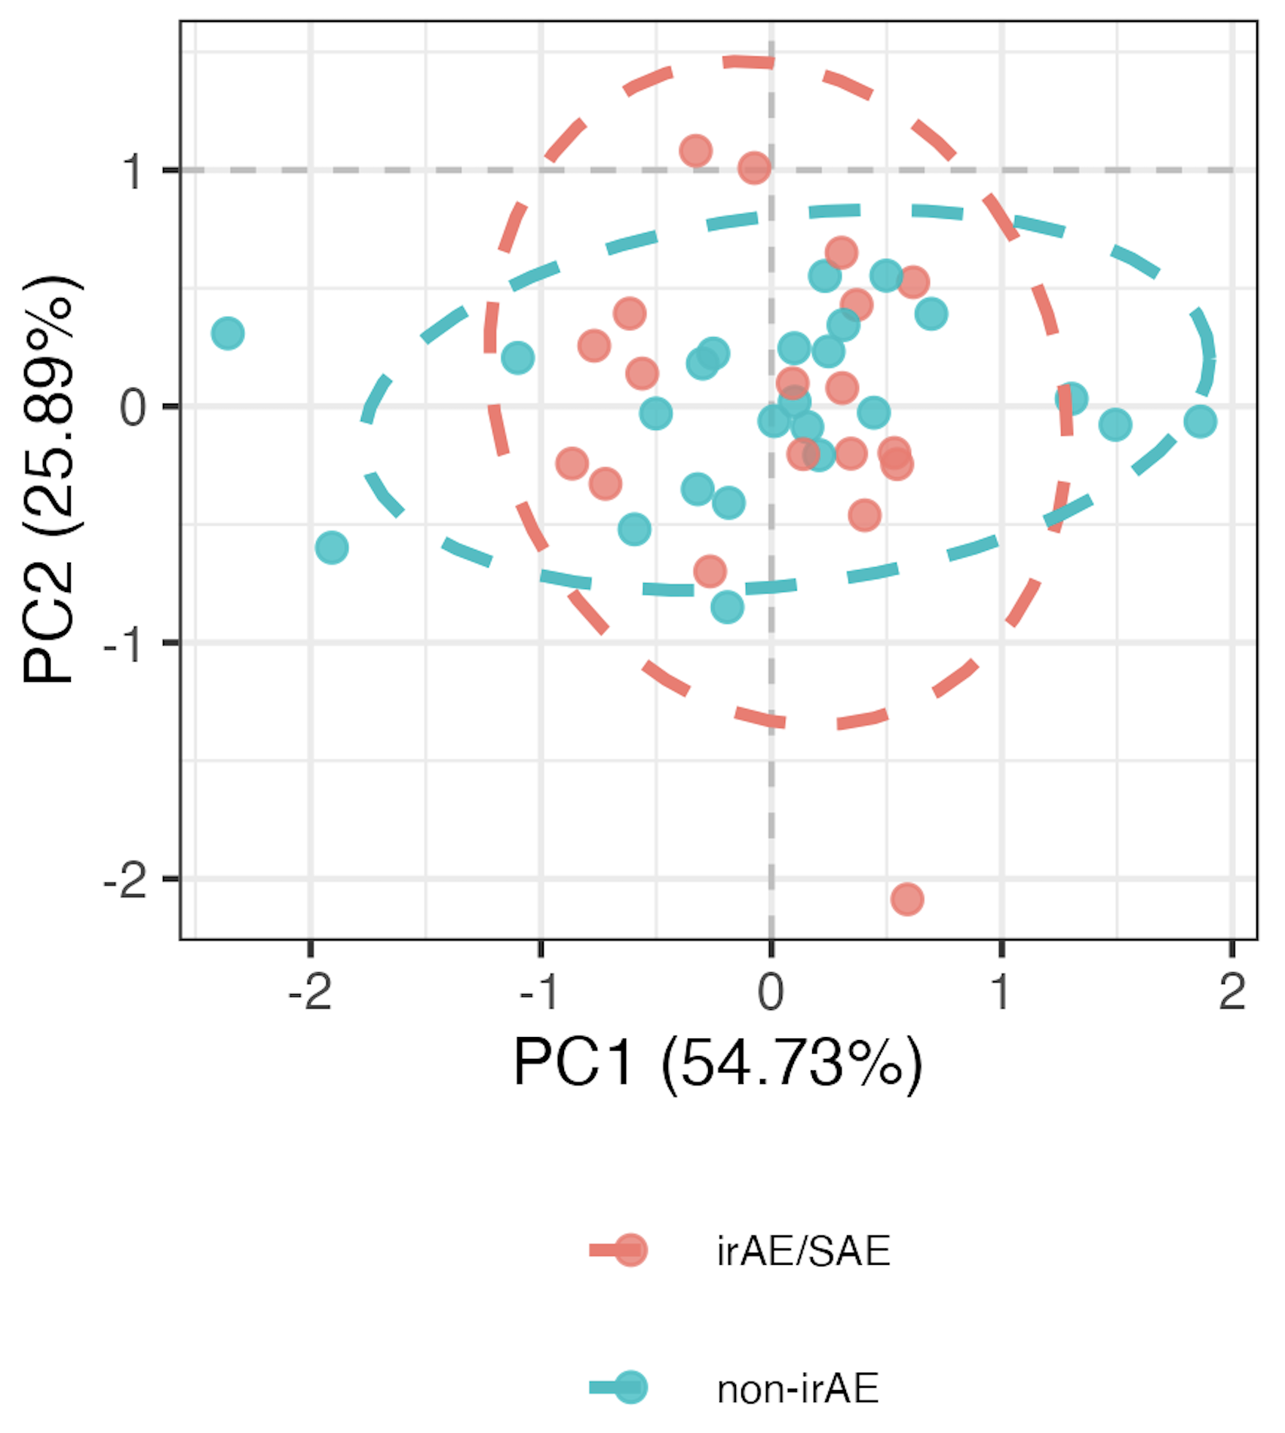
Comparison using bottom 4 features instead
Notes:
Pvals > 0.9 here for PCs 1-3
Would really be better to take n random module samplings and test how often get significant separation in PCA…but didn’t get to that yet

Slide 8
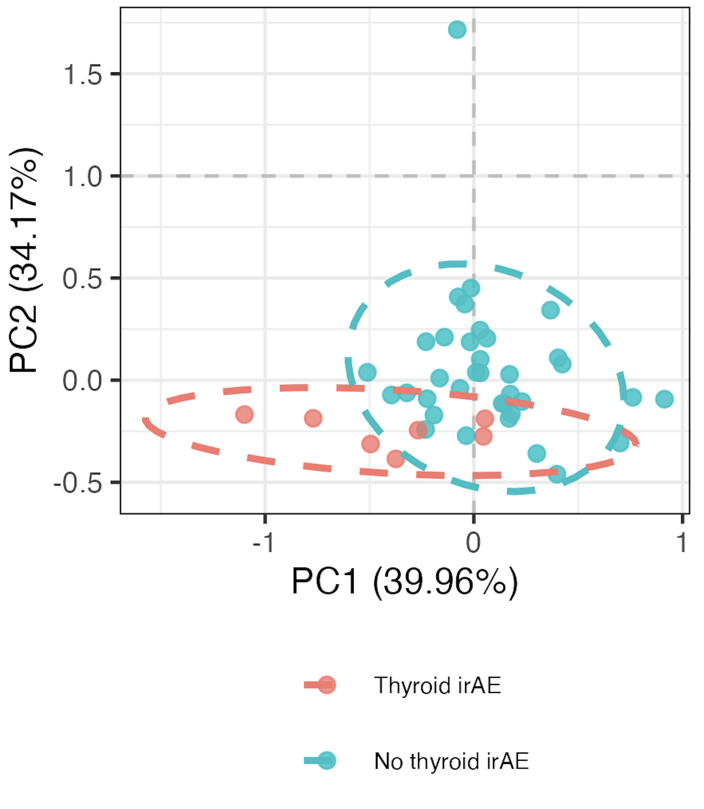
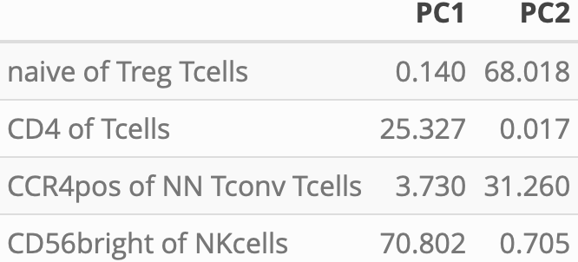
Distinguishing thyroid irAE group using module of top 4 thyroid irAE baseline features
PC1-2 contributions
PC1 *
PC2 **
**: p < 0.01, *: p < 0.05
Notes:
~similar if including OOR in sense that module needed, contributing features are mostly different (CD4 of T cells present both ways)

Slide 9
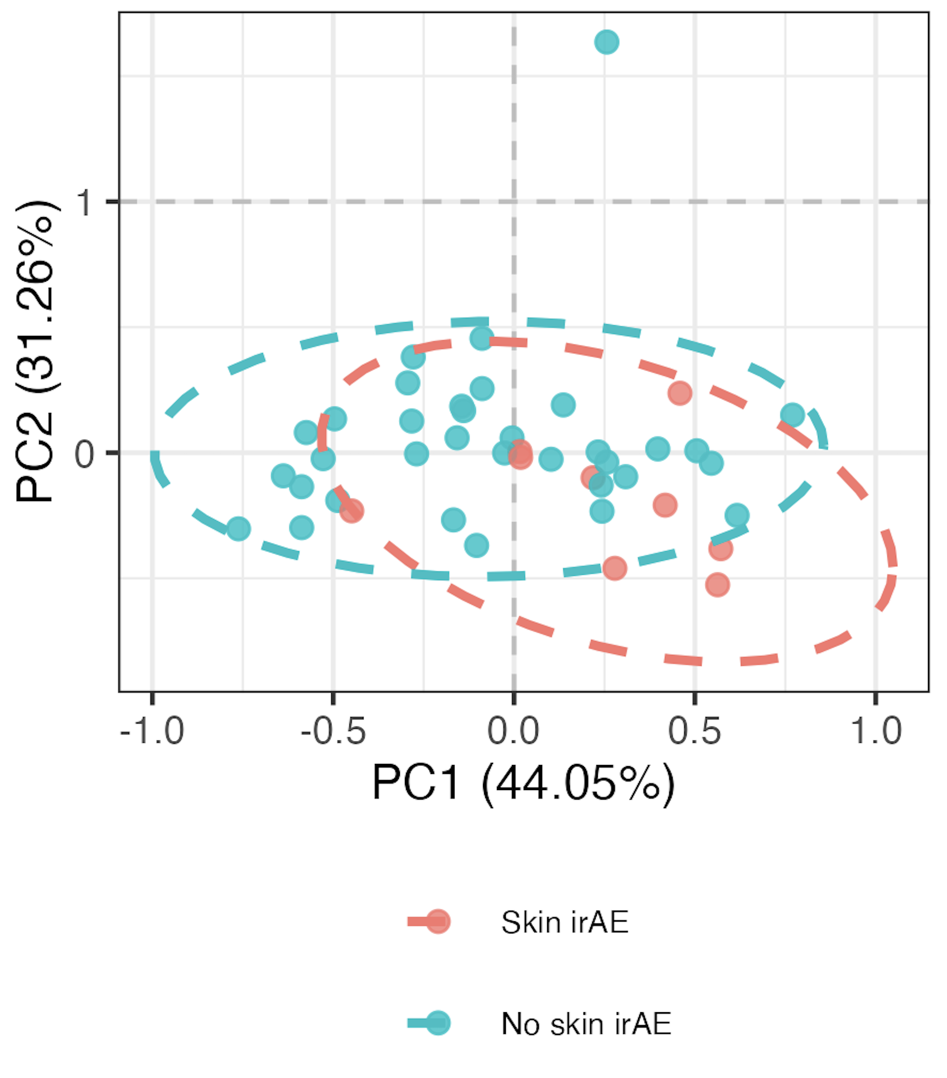
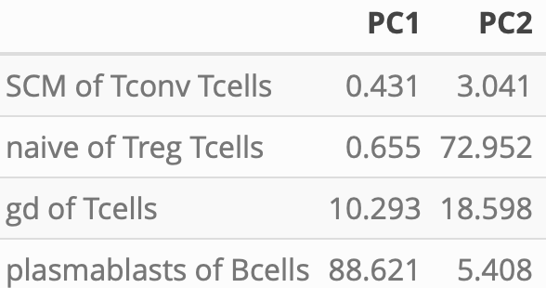
Distinguishing skin irAE group using module of top 4 skin irAE baseline features
PC1-2 contributions
PC1 *
PC2 *
**: p < 0.01, *: p < 0.05

Slide 10
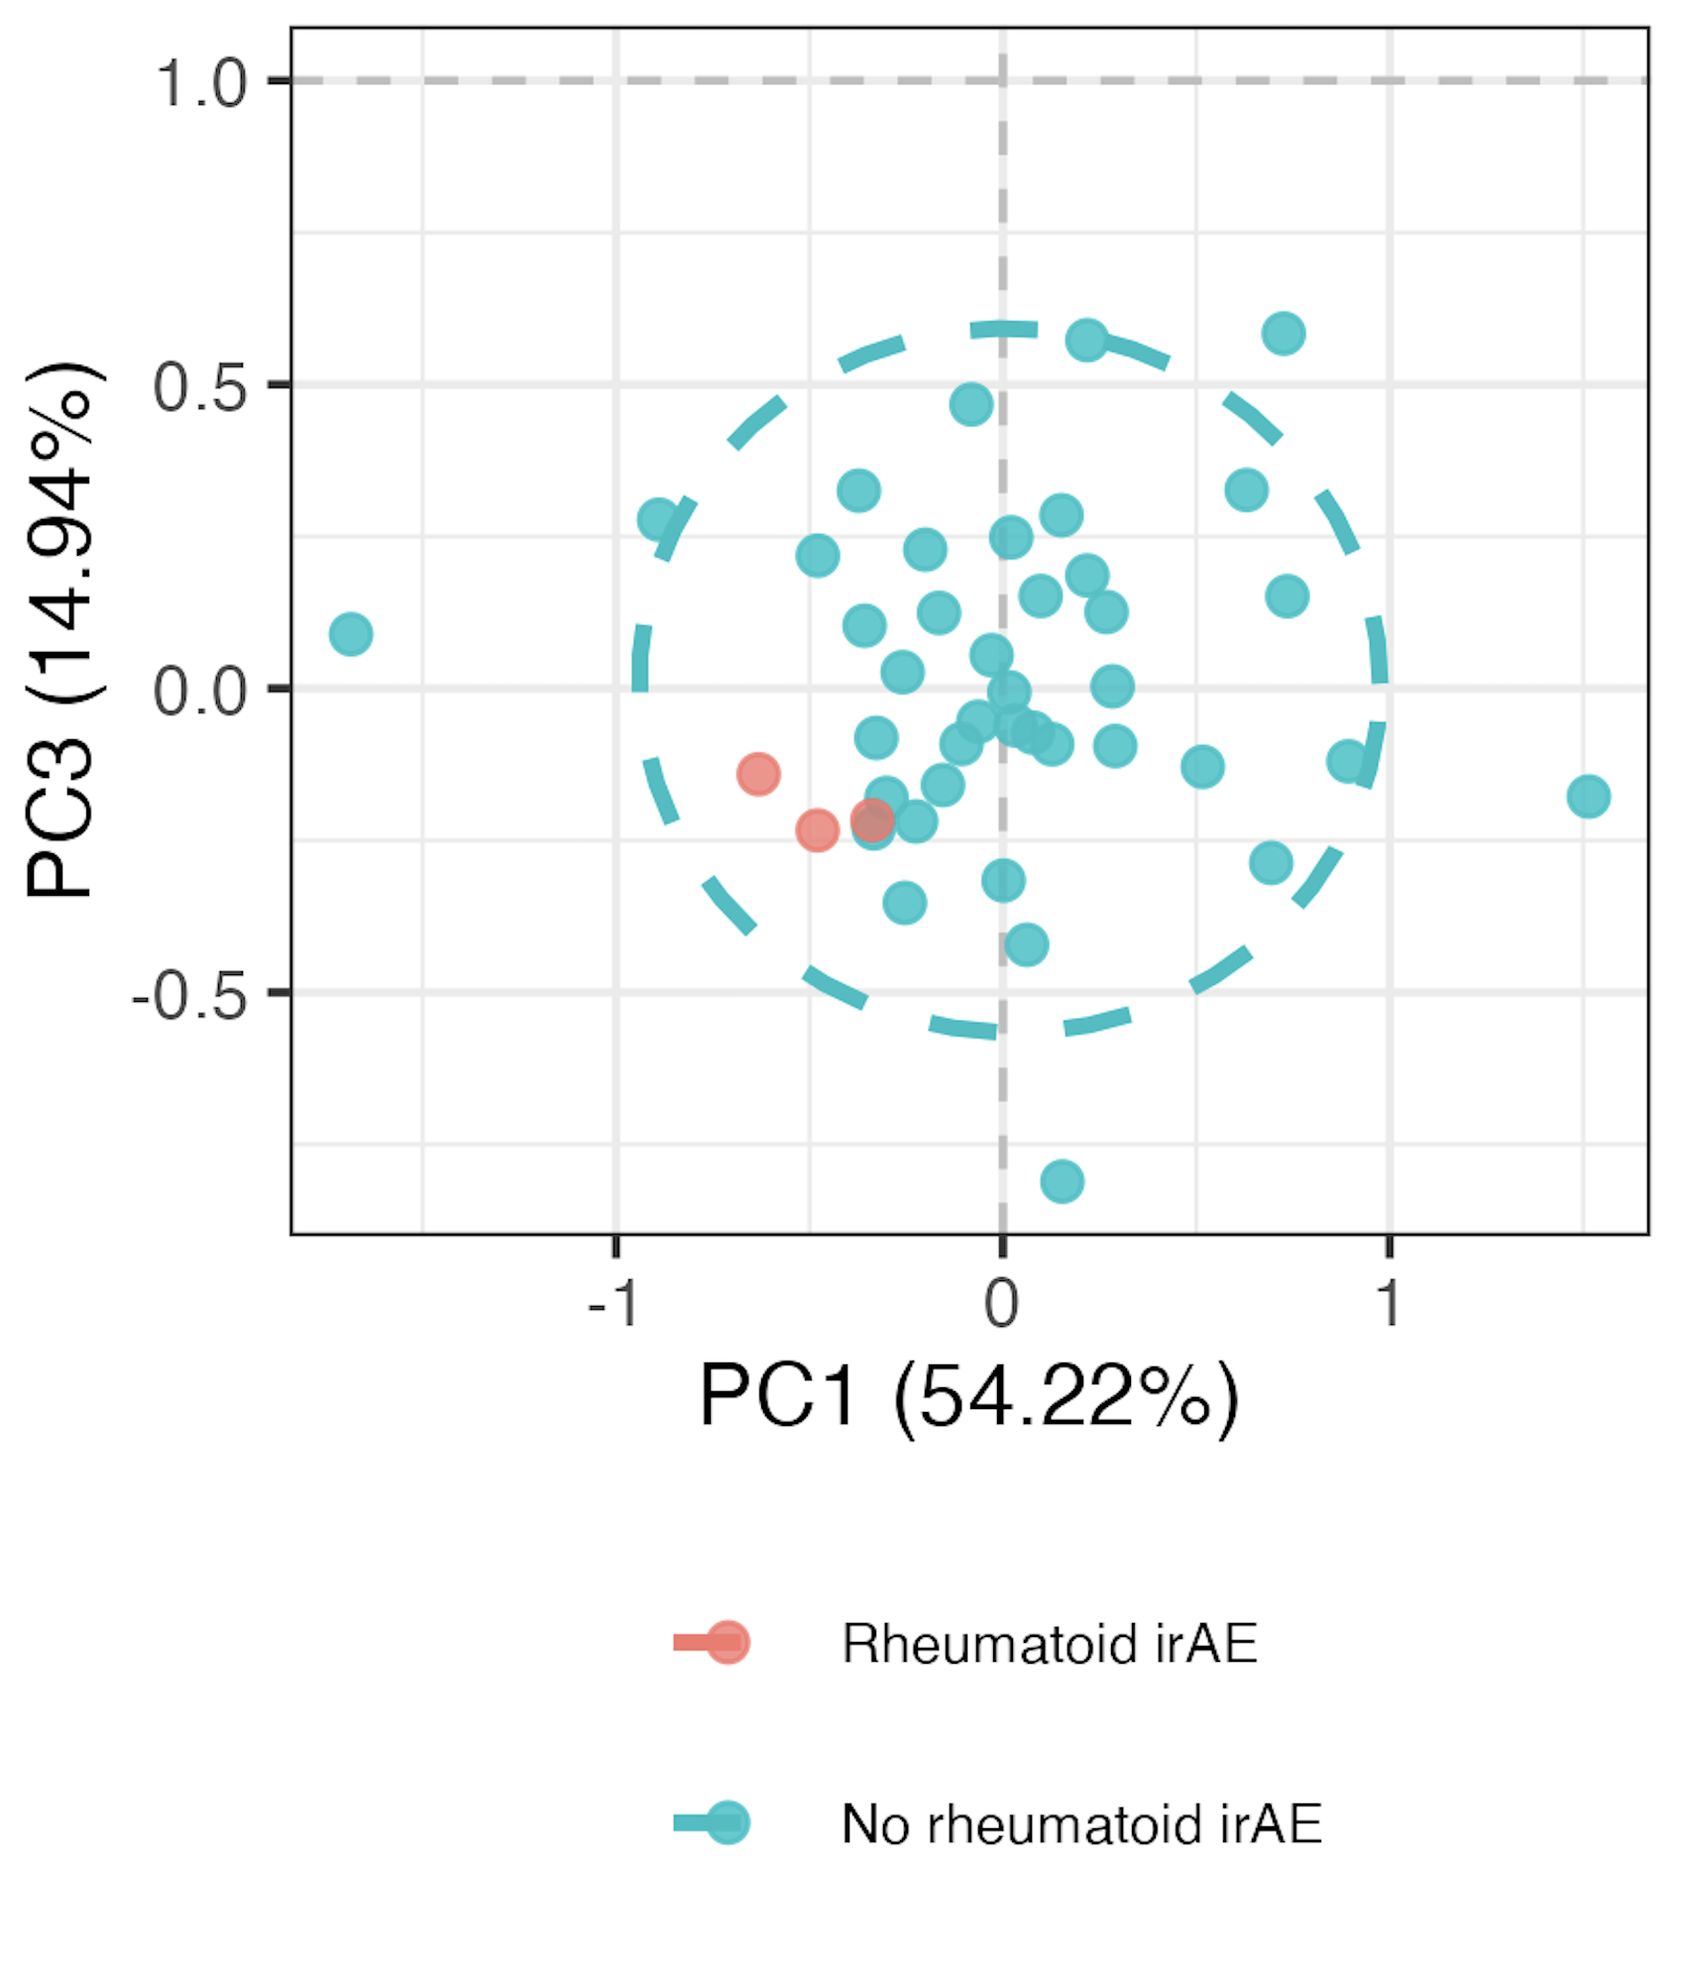
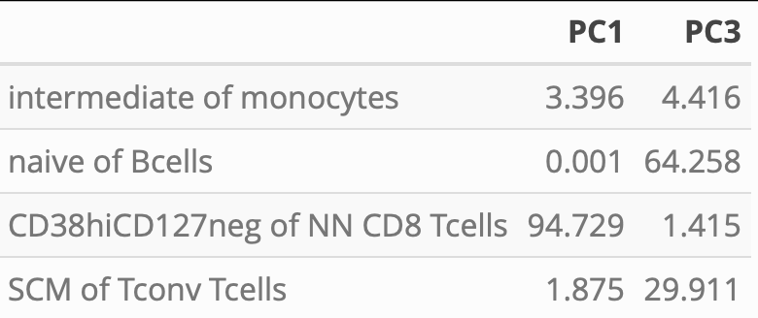
Distinguishing “rheumatoid” irAE group using module of top 4 “rheumatoid” irAE baseline features
PC1/3 contributions
PC1 ** PC3 **
**: p < 0.01, *: p < 0.05
Notes:
Opposite their result, but it was baseline

Slide 11
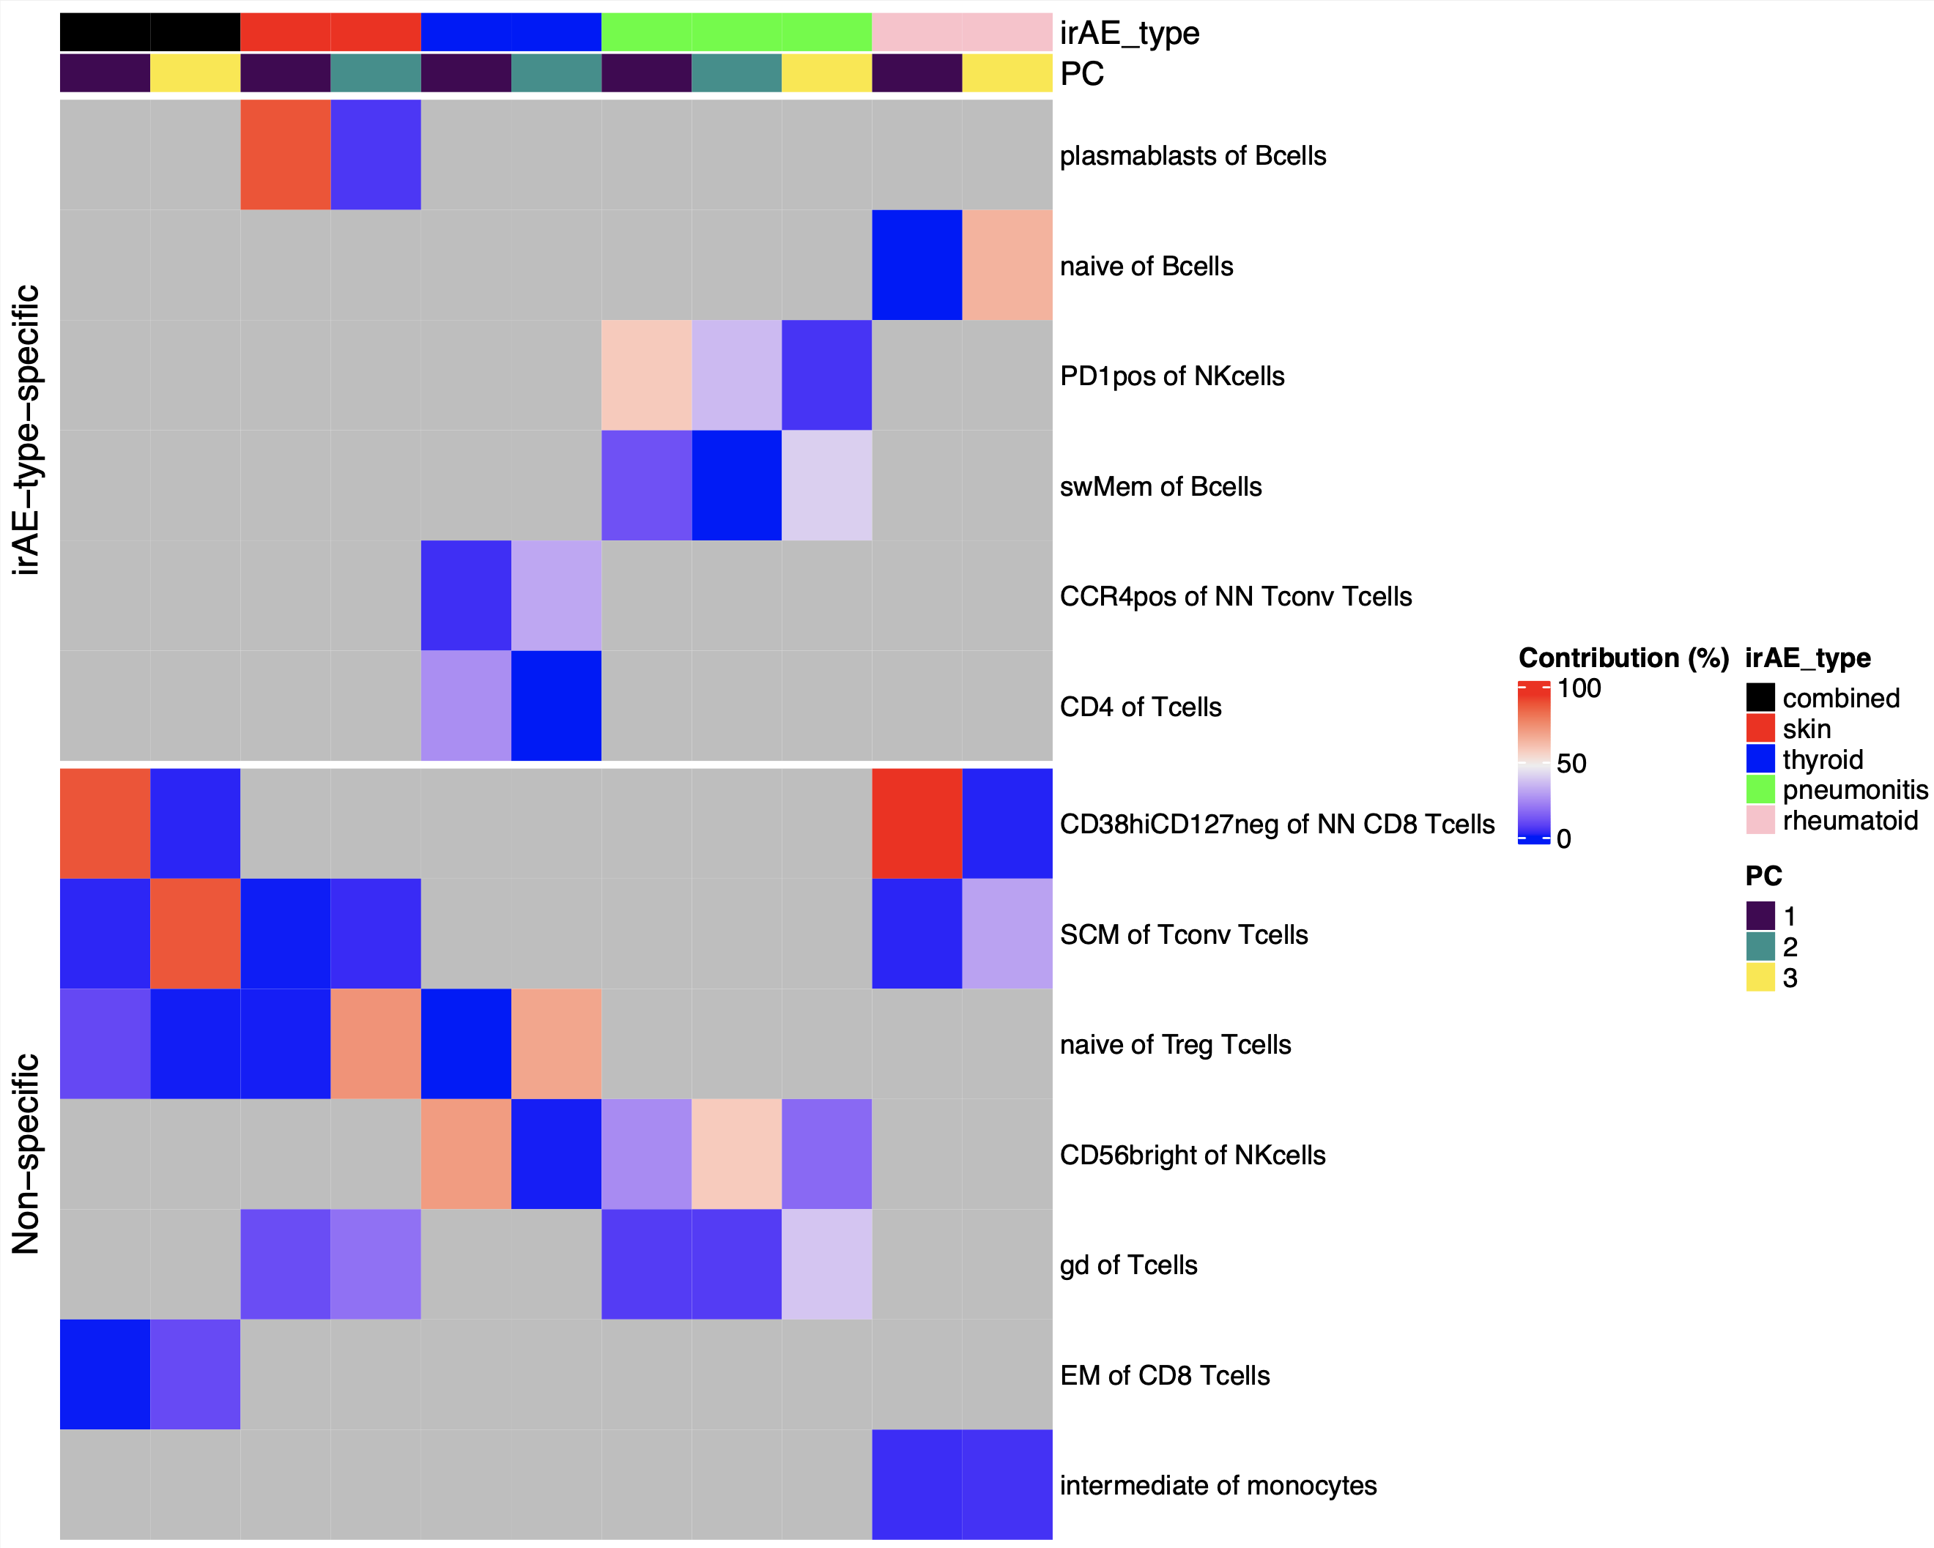
Summary of baseline module analysis: several features appear more irAE-type-specific
reported enriched in ICI-arthritis joints (Wang et al. Sci Immunol., 2023)
reported lower in severe irAE patients at irAE time (Kovacsovics-Bankowski et al. J Immunother Cancer. 2024)
Notes:
Only showing PCs with p < 0.05 for group comparison

Slide 12
Longitudinal analysis methods
Removed PD1⁺ features (15)
Used mixed effect non-linear model with interaction between irAE group & visit, random effect for donor
Looked for significant interactions between irAE group & visit (different slopes from baseline)
model <- gam(freq ~ irae_group * visit + s(patient_id, bs = "re"), data = data, method = 'REML')
Notes:
REML (Restricted Maximum Likelihood) is a statistical technique used for parameter estimation, particularly in mixed-effects models and generalized additive models (GAMs)
Also may be worth mentioning that I called “visit 2, irAE” just ”visit 2” (same for visit 3, irAE) rather than grouping them with irAE visit which I think makes more chronological sense…

Slide 13
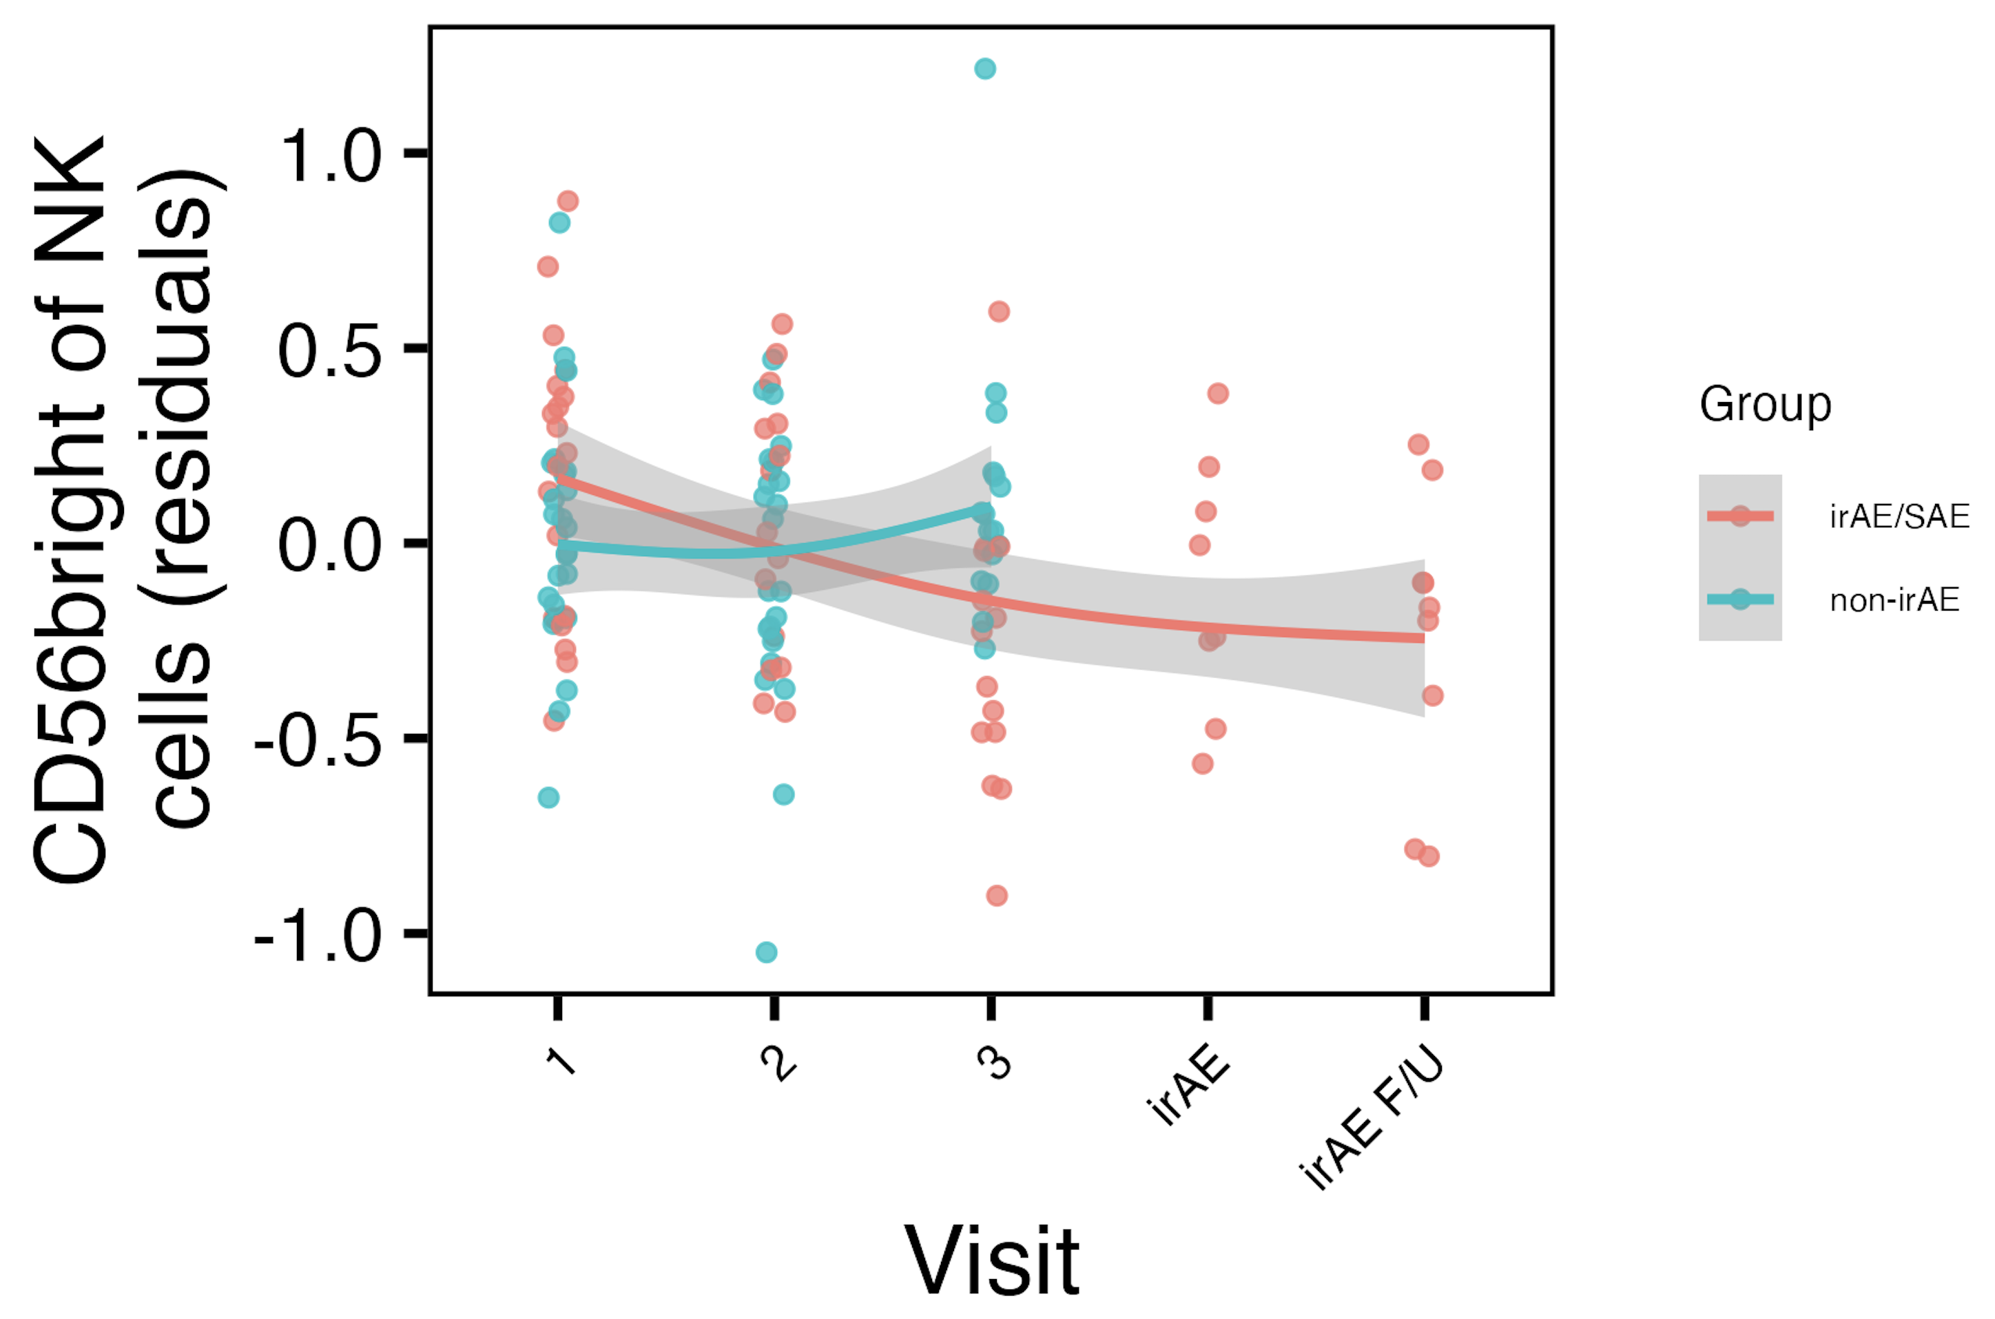
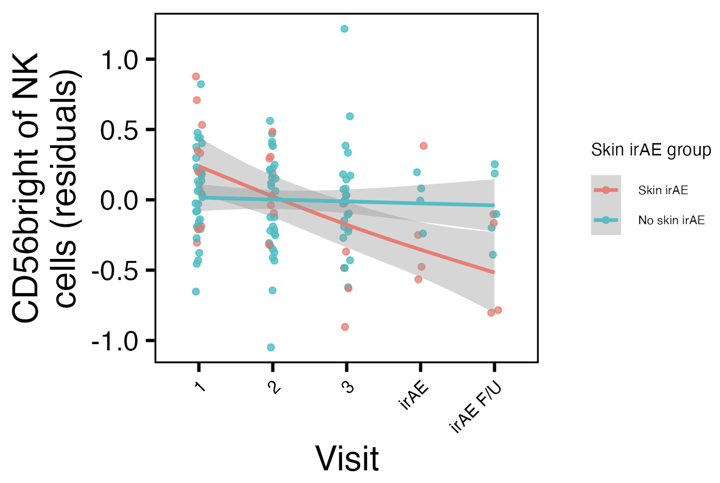
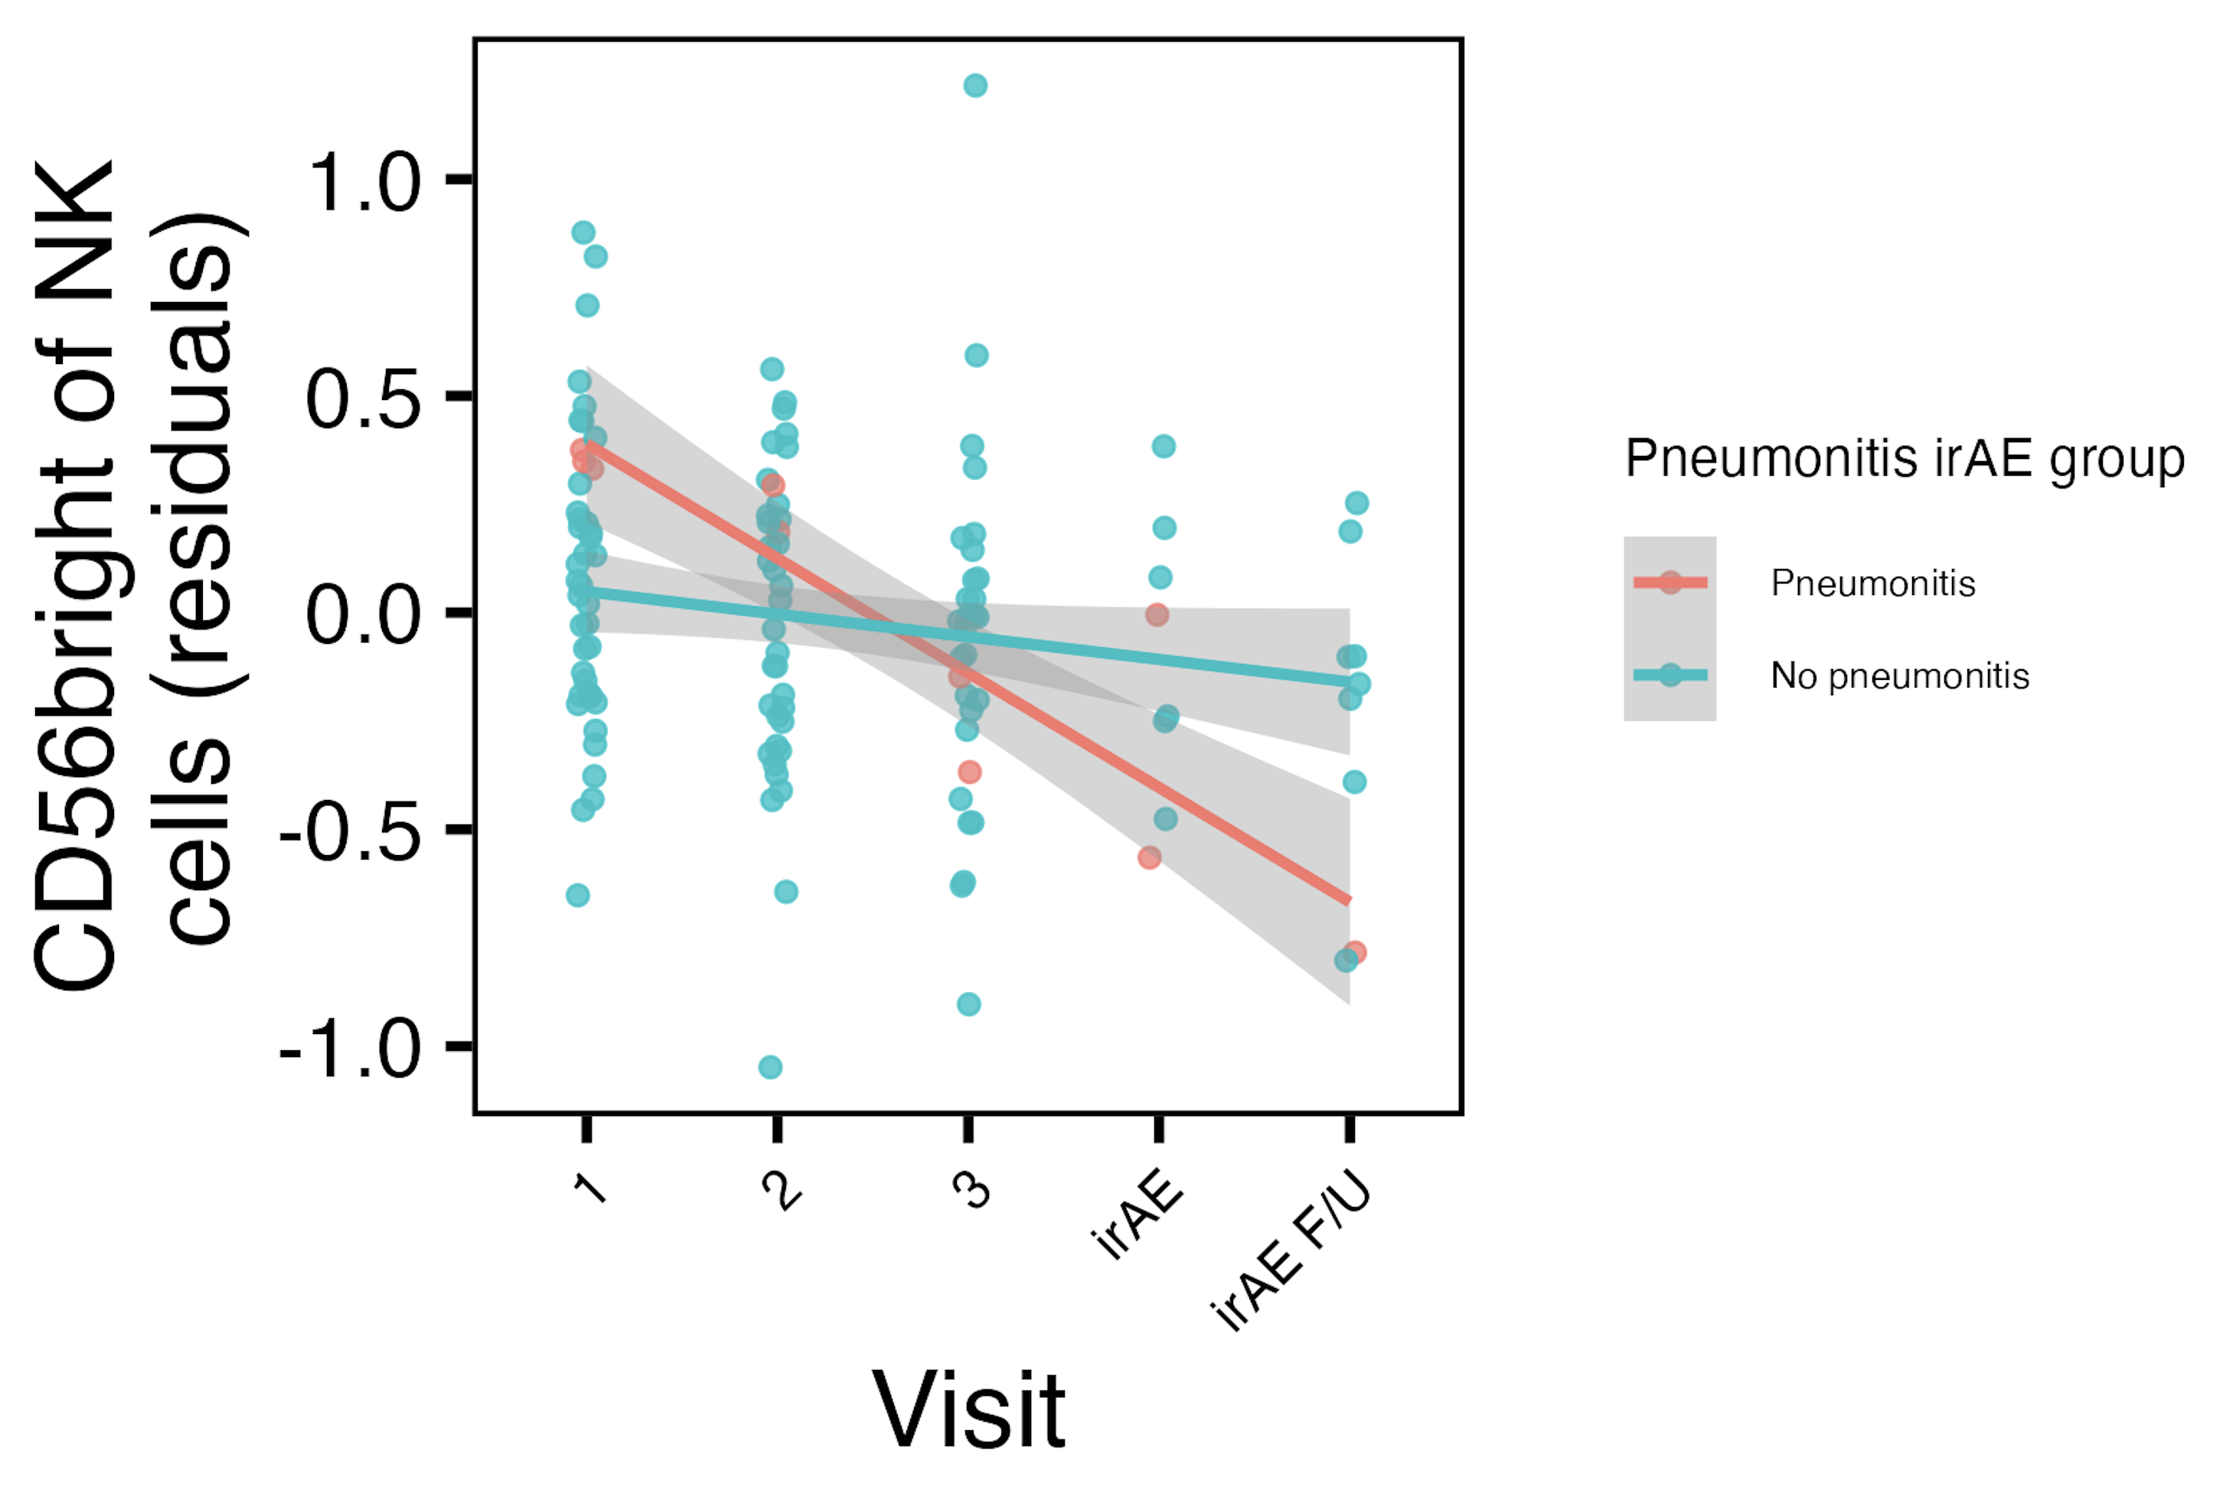
Frequency of CD56^{bright} of NK cells decreases with ICI specifically in combined irAE and skin irAE groups
*
*
CD56^{bright} of NK frequency reported lower in severe irAE patients at irAE time (Kovacsovics-Bankowski et al. J Immunother Cancer. 2024)
*: padj < 0.05
Notes:
See same trend in skin irAE group for CD56bright of NK, and this matches finding from Kovacsovics-Bankowski et al. J Immunother Cancer. 2024 (lower CD56bright of NK in patients at irAE max), surprisingly despite their cohort was mostly not pulmonary irAE and was mostly melanoma!

Slide 14
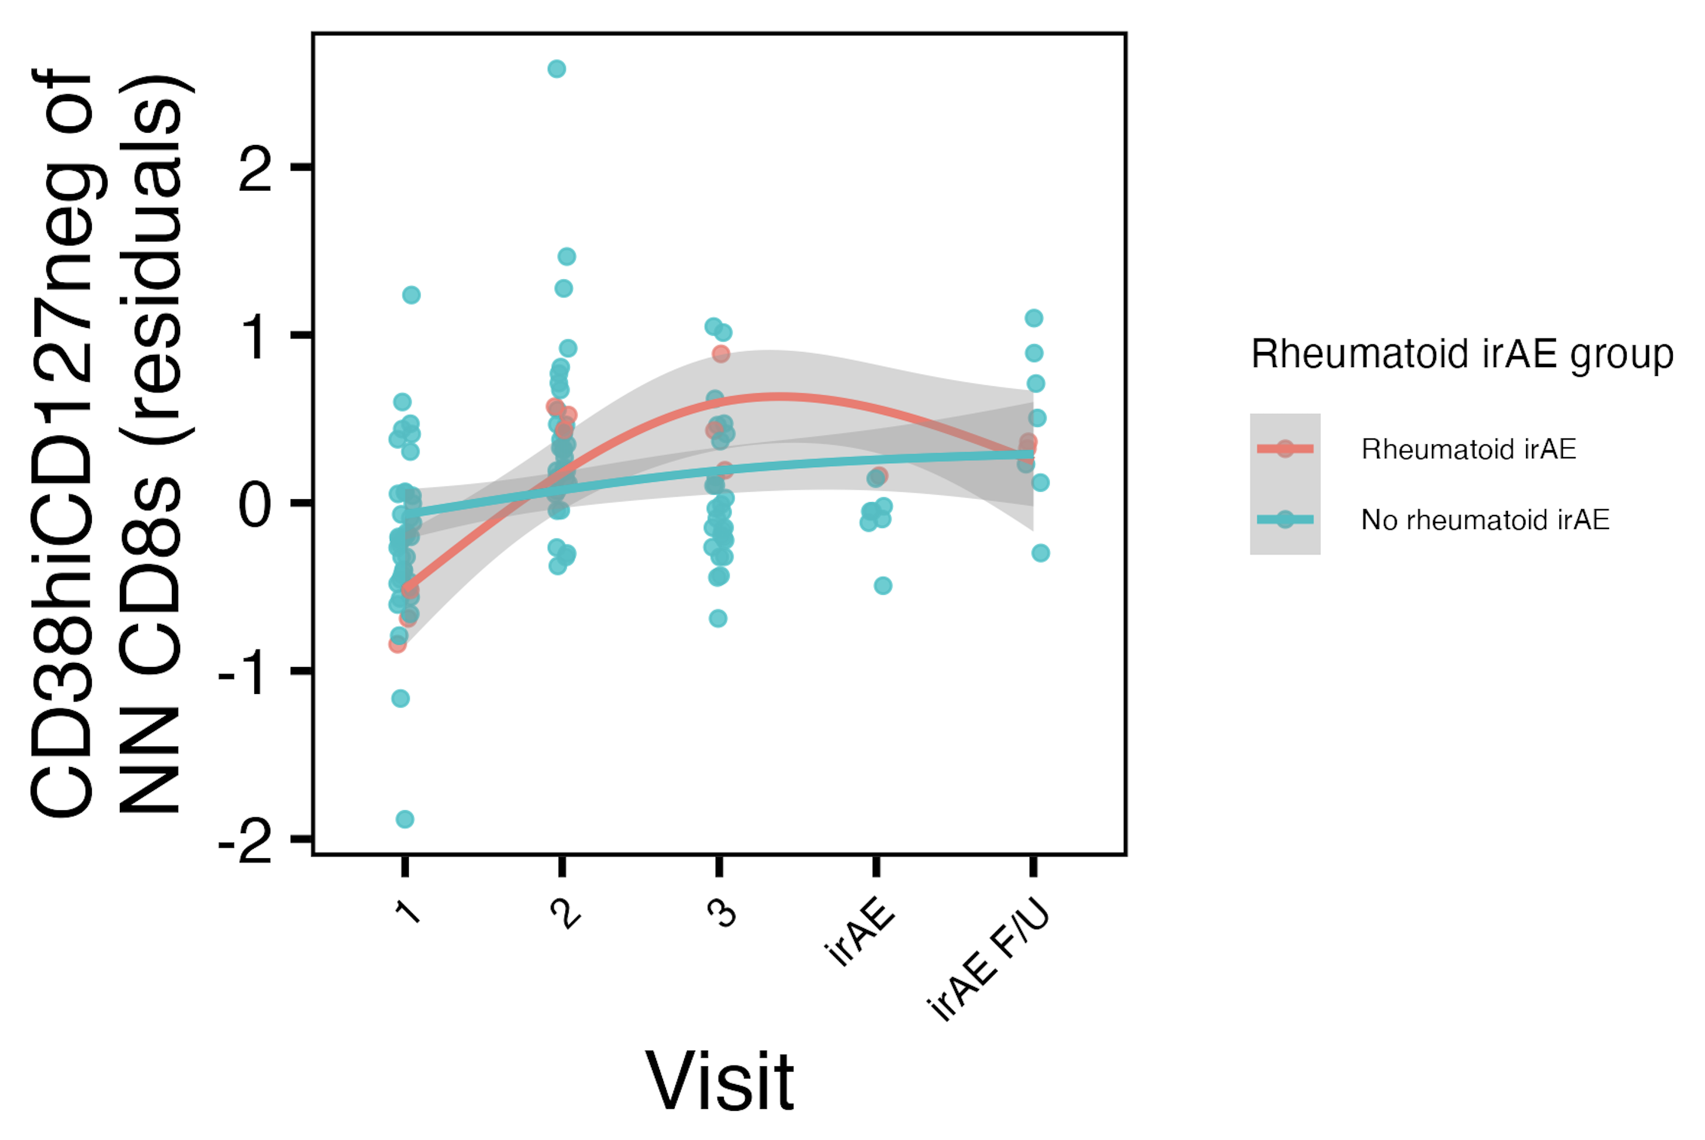
Frequency of CD38^{hi}CD127⁻ of NN CD8s may increase more in “rheumatoid” irAE group
CD38^{hi}CD127⁻ CD8s reported enriched in ICI-arthritis joints (Wang et al. Sci Immunol., 2023)
Notes:
# for rheumatoid, interaction (group-visit3) effects for DN of Tcells (padj = 0.044) and CRTH2+ of NN Tconv Tcells (padj = 0.015)

Slide 15
Conclusions
Baseline analyses
CD56^{bright} of NK cells frequency higher, PD1⁺ of NK cells frequency lower in those developing pneumonitis
some features appear more irAE-type specific
can use module of features to identify immunotypes of combined irAE, thyroid irAEs, skin, “rheumatoid” irAEs
Longitudinal analyses: some feature frequencies change with ICI in irAE group-specific manner
CD56^{bright} of NK frequency decreases with ICI in skin/combined irAE groups
other features’ frequencies change in irAE group-specific manners over ICI (data not shown)

Slide 16
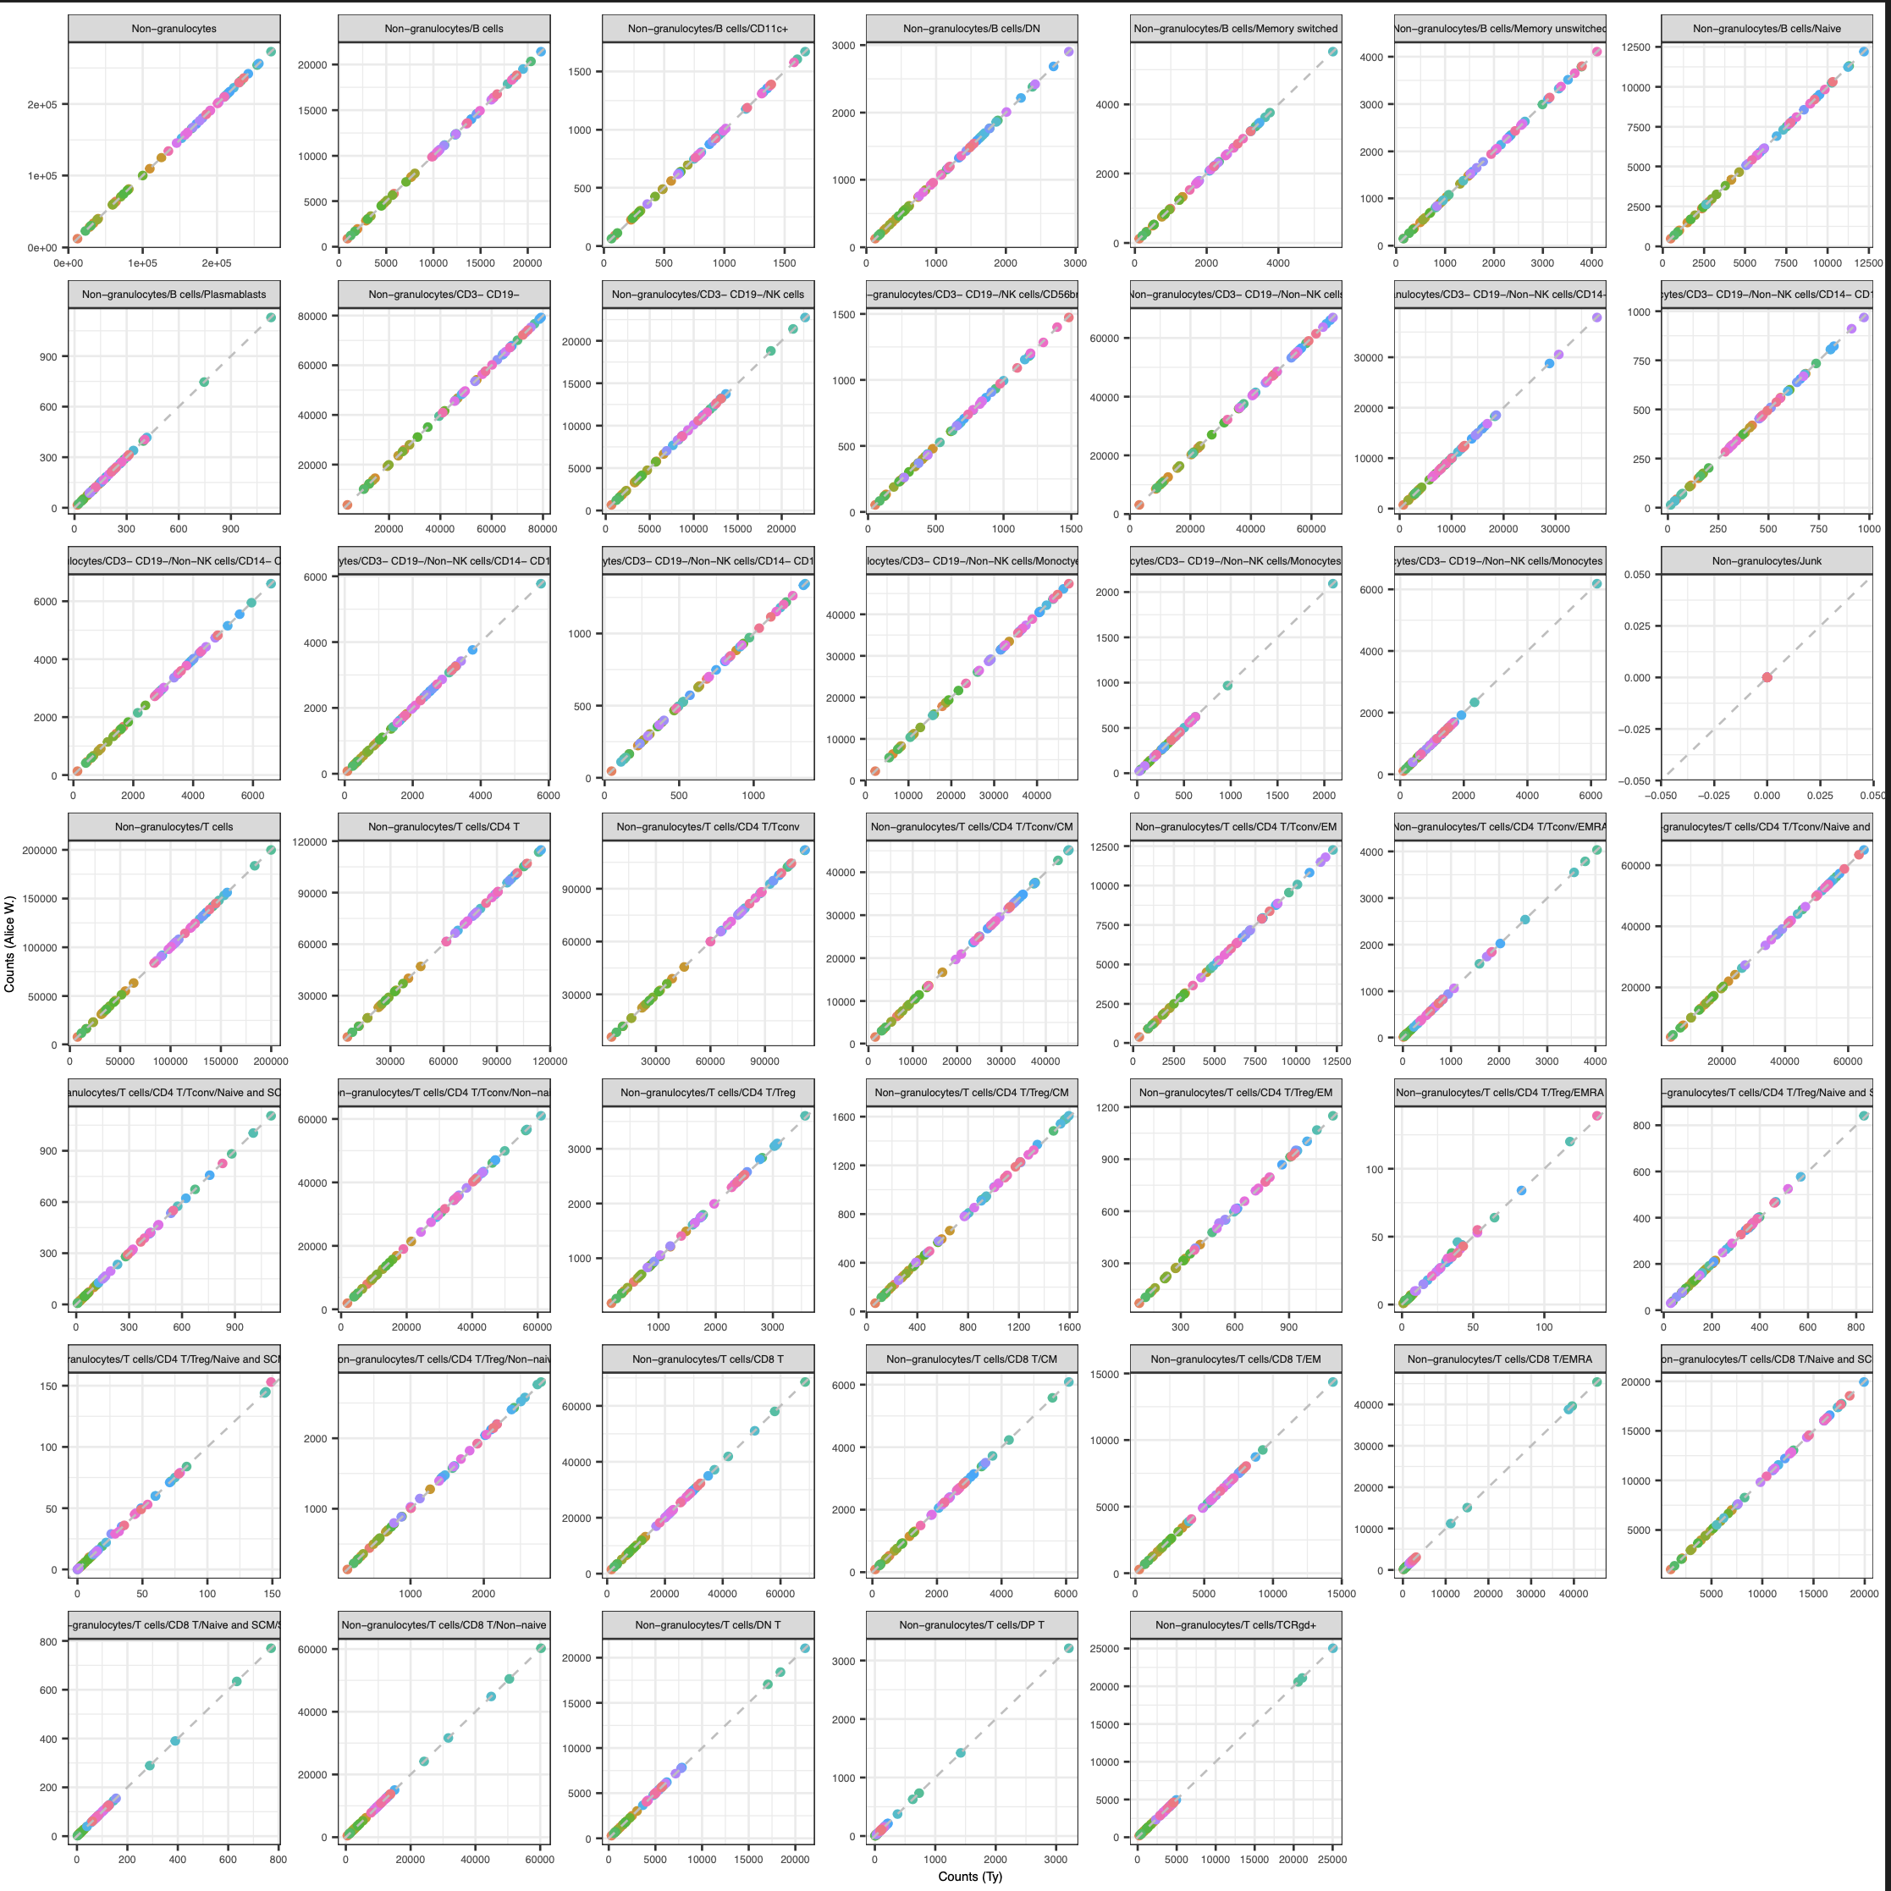
Next steps
IMPACD
created gating set in R, counts are ~expected values
will next look at gating at multiple, hierarchical levels
Test results in public datasets
Notes:
Public data test is likely ~complicated by needing similar cohorts to see same effects

Slide 17

Acknowledgements
Holly Akilesh
Long lab/HIPcore
Alice Long, Alice Wiedeman
Buckner lab
Jane Buckner, Sylvia Posso
Peter Linsley
Hannah DeBerg
Clinical team

Slide 18
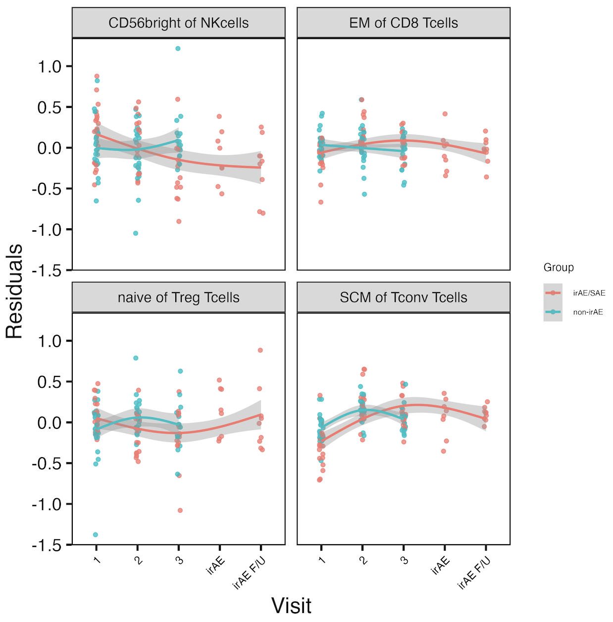
Other longitudinal combined irAE results
*
*
*
*
*
*: padj < 0.05
Notes:
See same trend in skin irAE group for CD56bright of NK, and this matches finding from Kovacsovics-Bankowski et al. J Immunother Cancer. 2024 (lower CD56bright of NK in patients at irAE max), surprisingly despite their cohort was mostly not pulmonary irAE and was mostly melanoma!

Slide 19
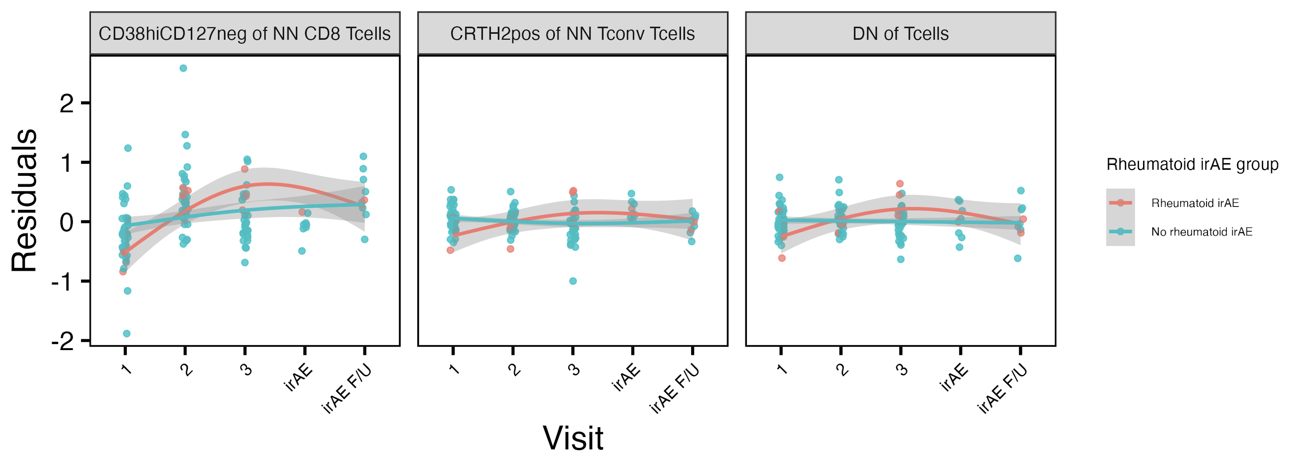
Other longitudinal “rheumatoid” irAE results
*
*
reported enriched in ICI-arthritis joints (Wang et al. Sci Immunol., 2023)
*: padj < 0.05
Notes:
# for rheumatoid, interaction (group-visit3) effects for DN of Tcells (padj = 0.044) and CRTH2+ of NN Tconv Tcells (padj = 0.015)

Slide 20
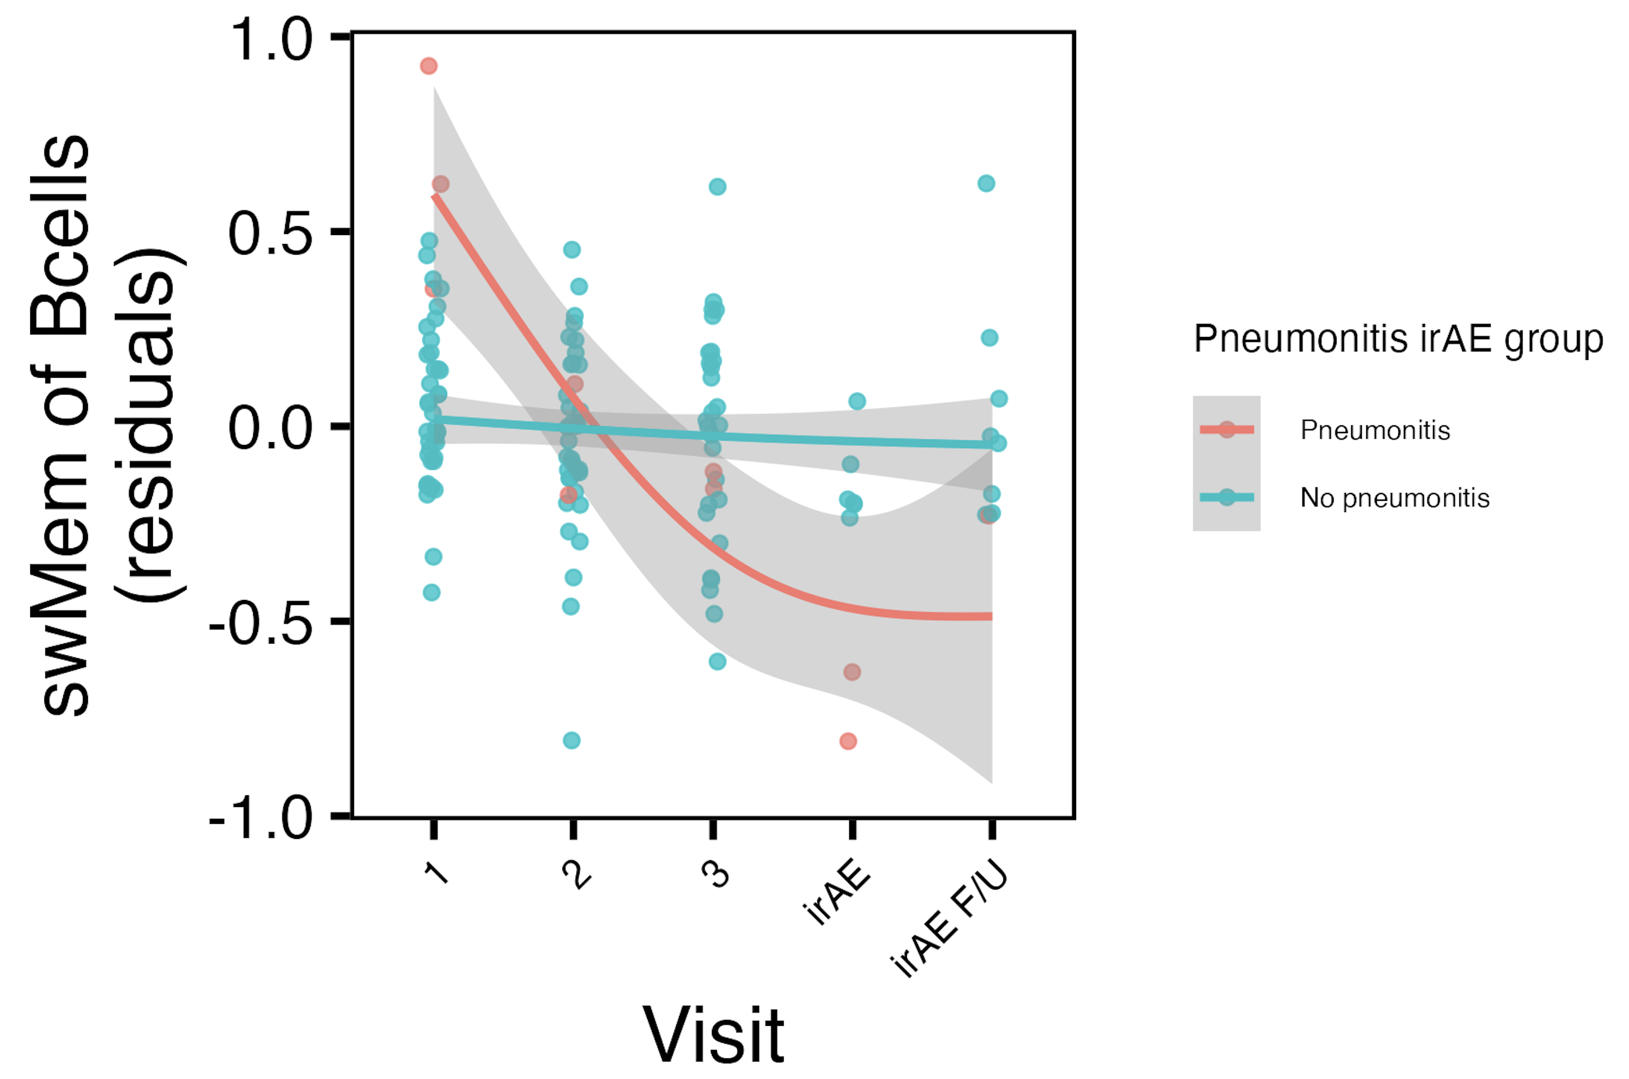
swMem of Bcells frequency decreases with ICI in pneumonitis irAE group
*
*: padj < 0.05

Slide 21
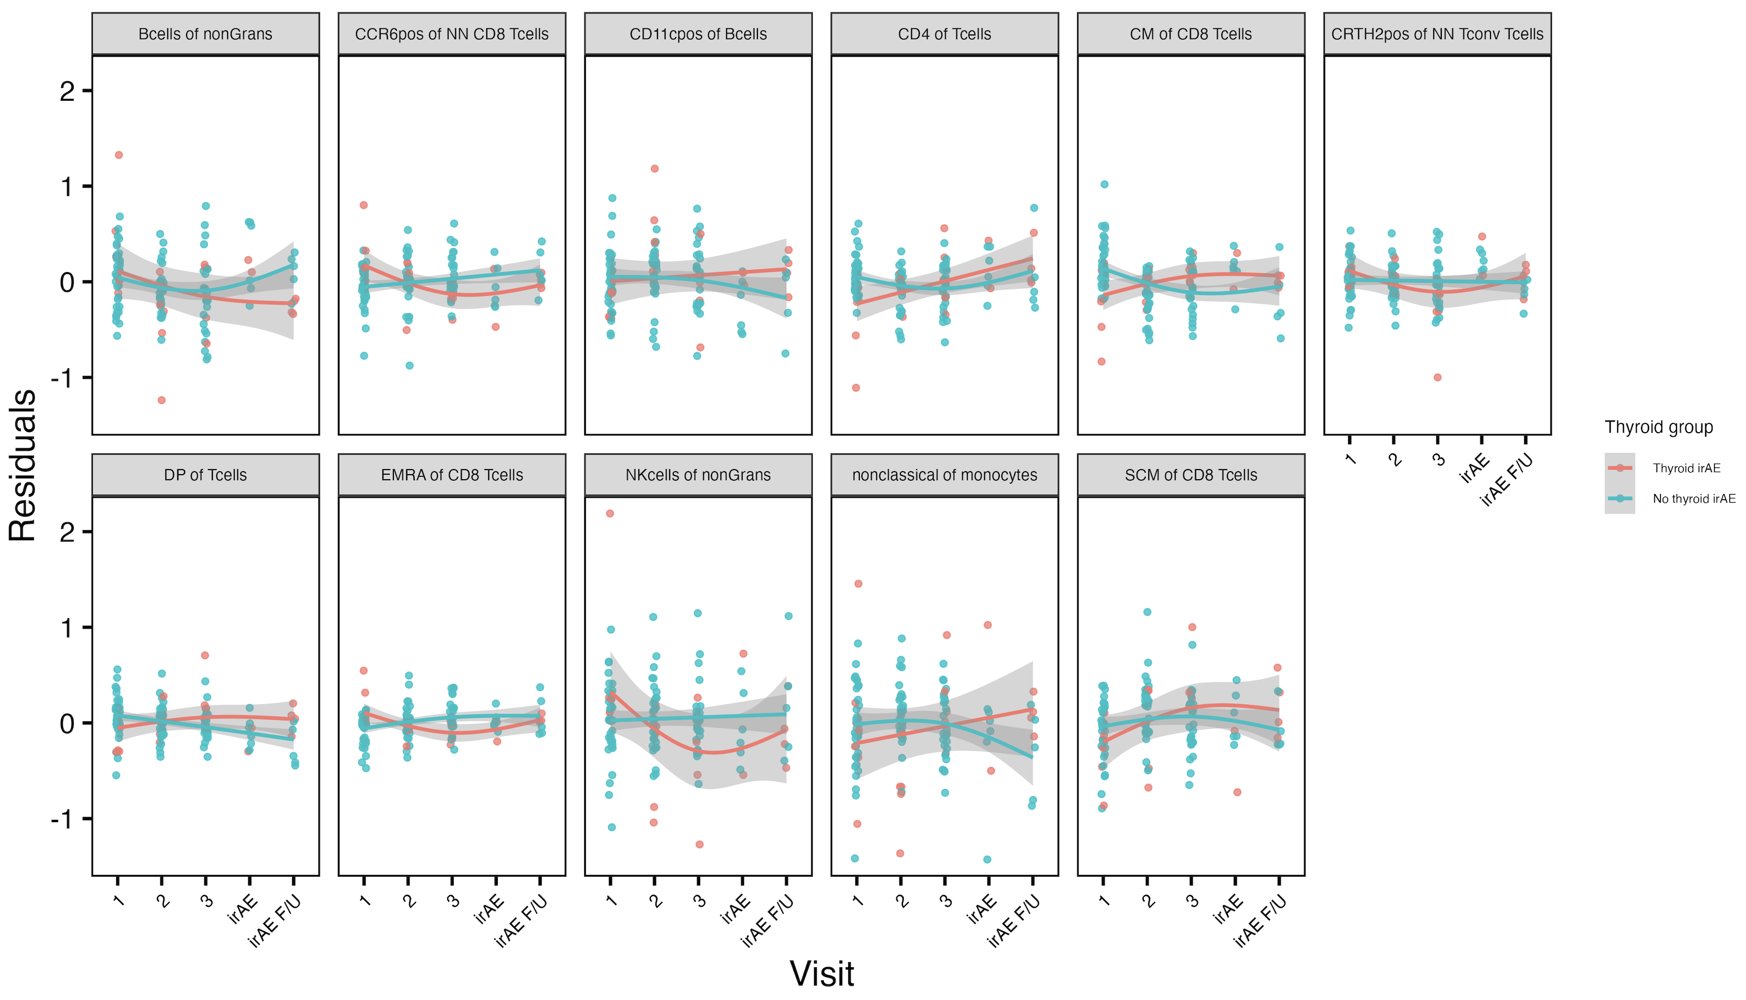
Several features’ frequencies change in thyroid irAE group-specific manner over visits
*
*
*
*
*
*
*
*
*
*
*
*
*
*
*
*: padj < 0.05

